Slide 1
Accelerated Bridge Construction in High Seismic Zones
M. Saiid Saiidi
Professor, Civil & Environmental Engineering
University of Nevada, Reno

Slide 2
Why high seismic zone matters?
ABC relies on precast members that are connected in the field.

Slide 3
Seismic Performance Requirement for Bridges
(cast-in-place or precast)
No collapse under strong earthquakes
Plastic hinging of columns- structural fuse
Capacity-protected cap beams and footings
ABC connections must ensure
  Column plastic hinging
  No damage to cap beams and footings

Slide 4
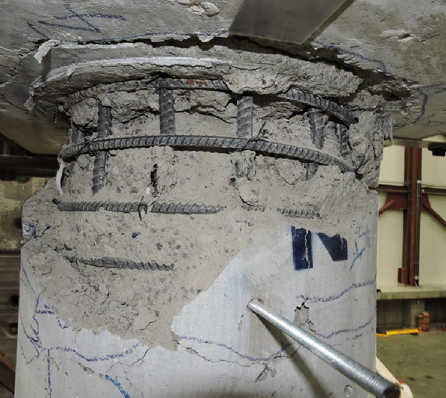
Post-Earthquake Column Damage State
Conventional
Plastic hinging of columns- structural fuse
Severe Damage
ABC
Plastic hinging of columns- structural fuse
QUESTION: Does ABC provide opportunity to raise the standard?

Slide 5
Connecting Columns to Cap Beams/Footings
Coupler Option
Grouted sleeves
Headed bar couplers
Swaged
Shear screw
Non-Coupler Option
Grouted ducts
Prestressed systems
Pocket connections
Embedded columns
Others
Pins/hinges
Replaceable connections
Etc.

Slide 6
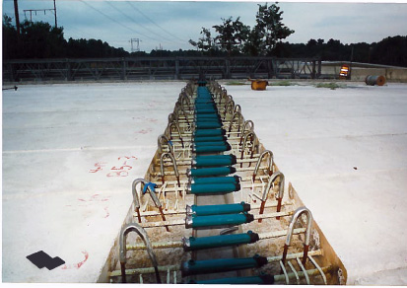
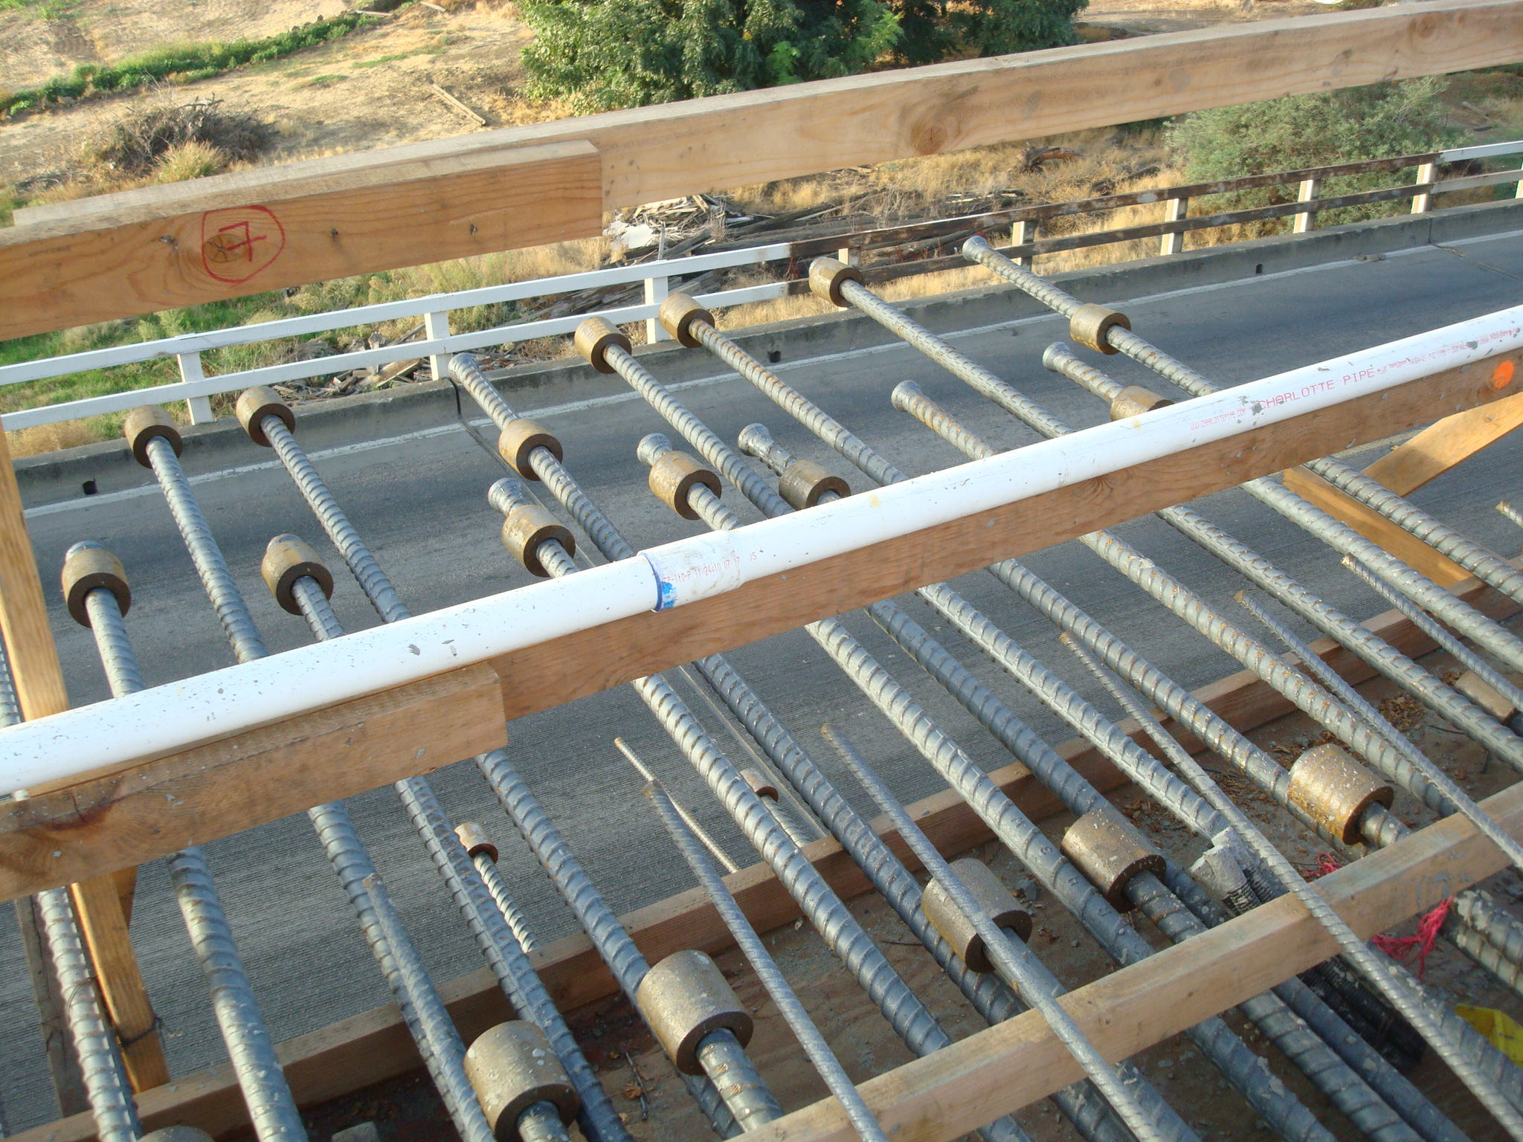
Coupler (Mechanical Bar Splice) Connections
Common in non-seismic applications
Code | Coupler Type | Plastic Hinge
AASHTO | Full Mech. Connection | No
Caltrans | Service | No
 | Ultimate | No
ACI | Type 1 | No
 | Type 2 | Yes

Slide 7
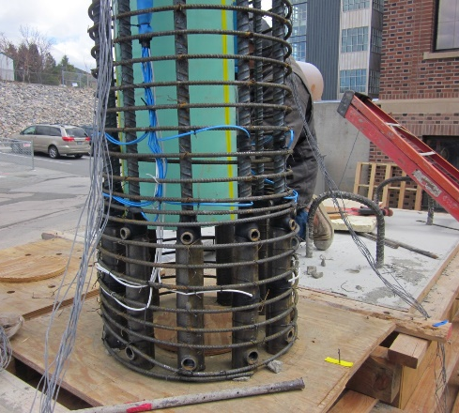
Recent Seismic Studies of Columns w/ Couplers
Grouted Couplers in Nevada, Utah, Florida
Displacement ductility of 4.5 or more
Headed Bar Couplers in Nevada
Displacement ductility of 7- same as CIP
QUESTION: Should the ban on couplers in plastic hinges be removed?

Slide 8
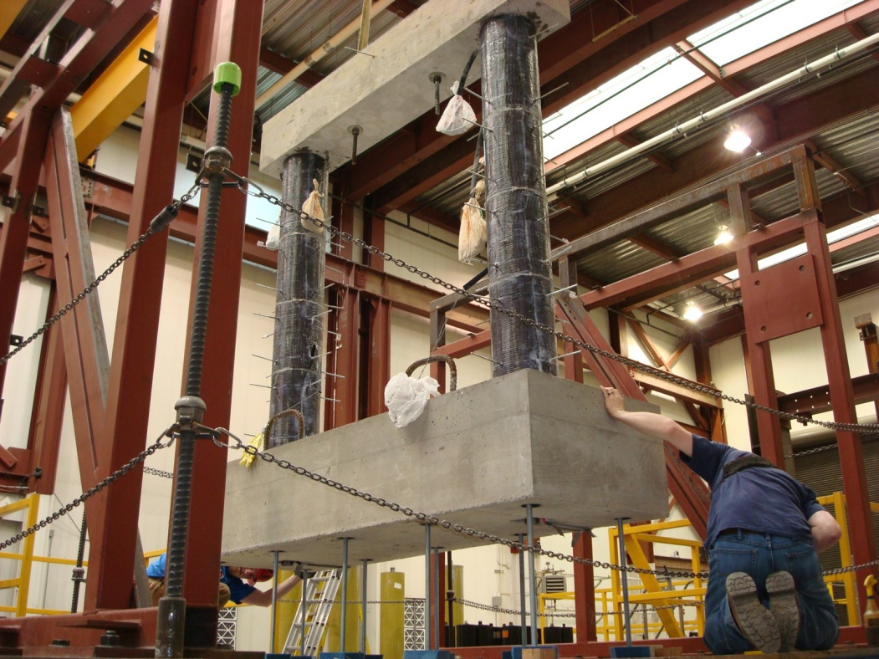
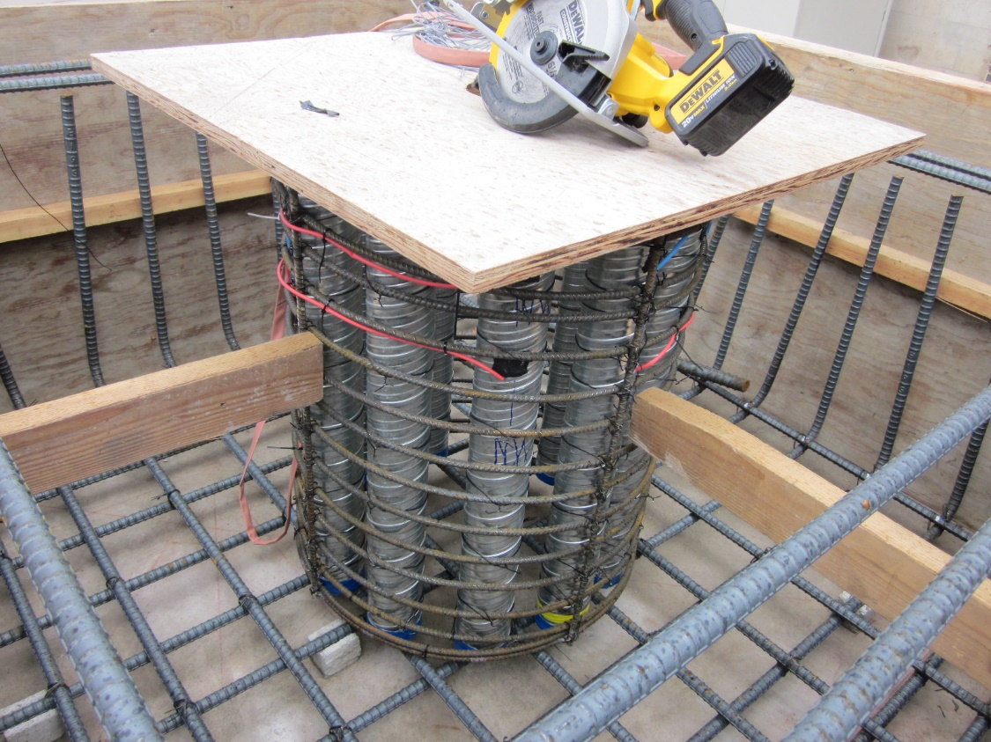
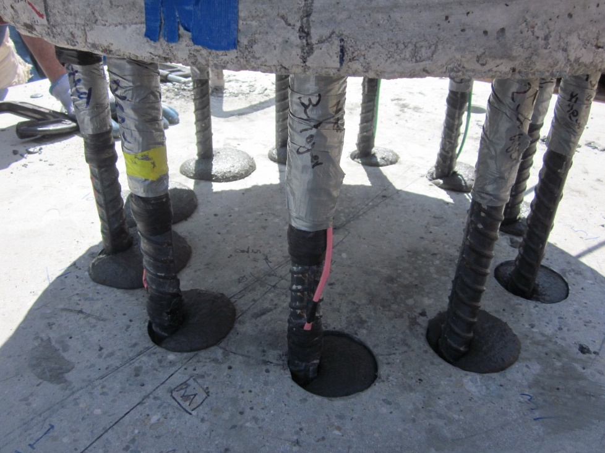
Non-Coupler Option
Grouted ducts
Prestressed systems
Pocket connections
Embedded columns
Prestressed Systems
Grouted
ducts

Slide 9


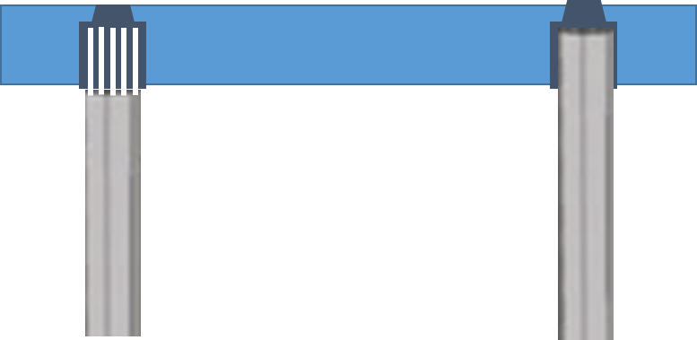
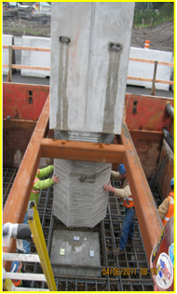
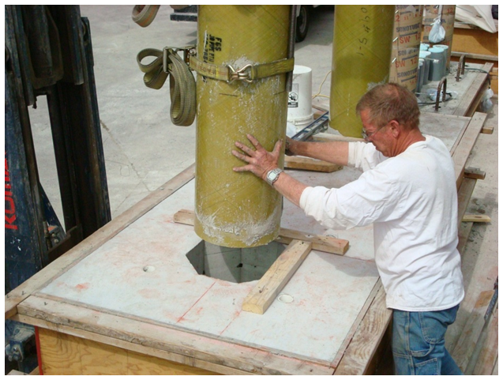

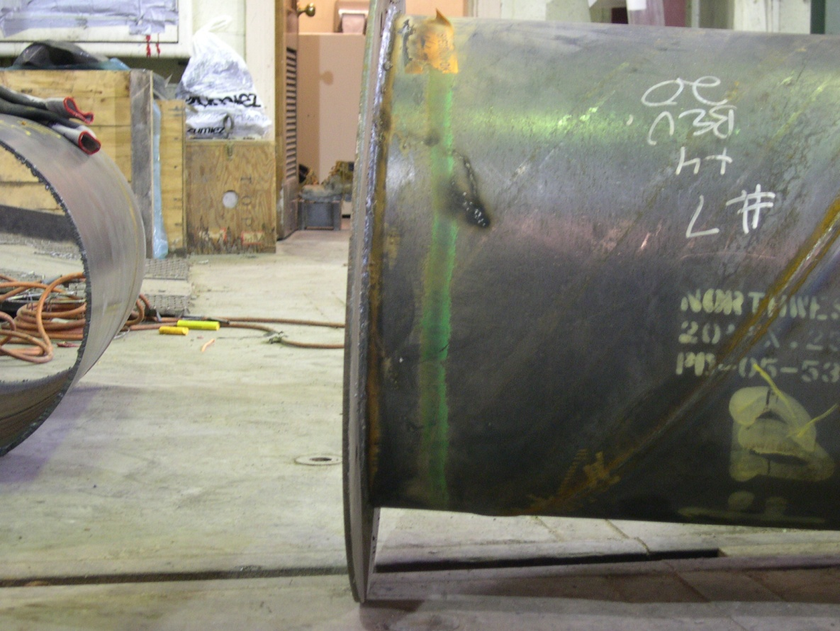
Embedded
Columns
Pocket Connections
Concrete-filled tube
column
Ring
anchorage

Slide 10
Recent Seismic Studies of Non-Coupler Connections Show Excellent Performance
QUESTION: Which one to use?
Anecdotal evidence: The one that is closest to conventional design– Grouted ducts?
Anchor column bars properly; no other design considerations

Slide 11
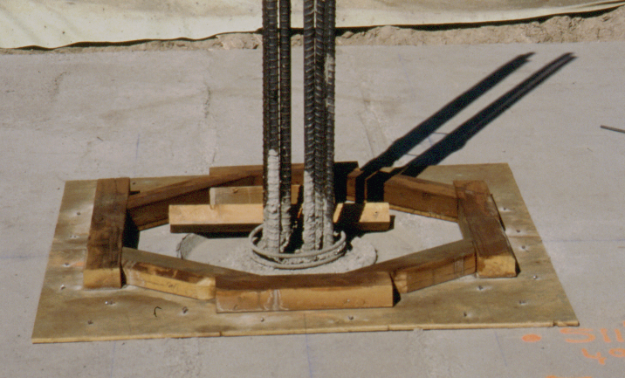
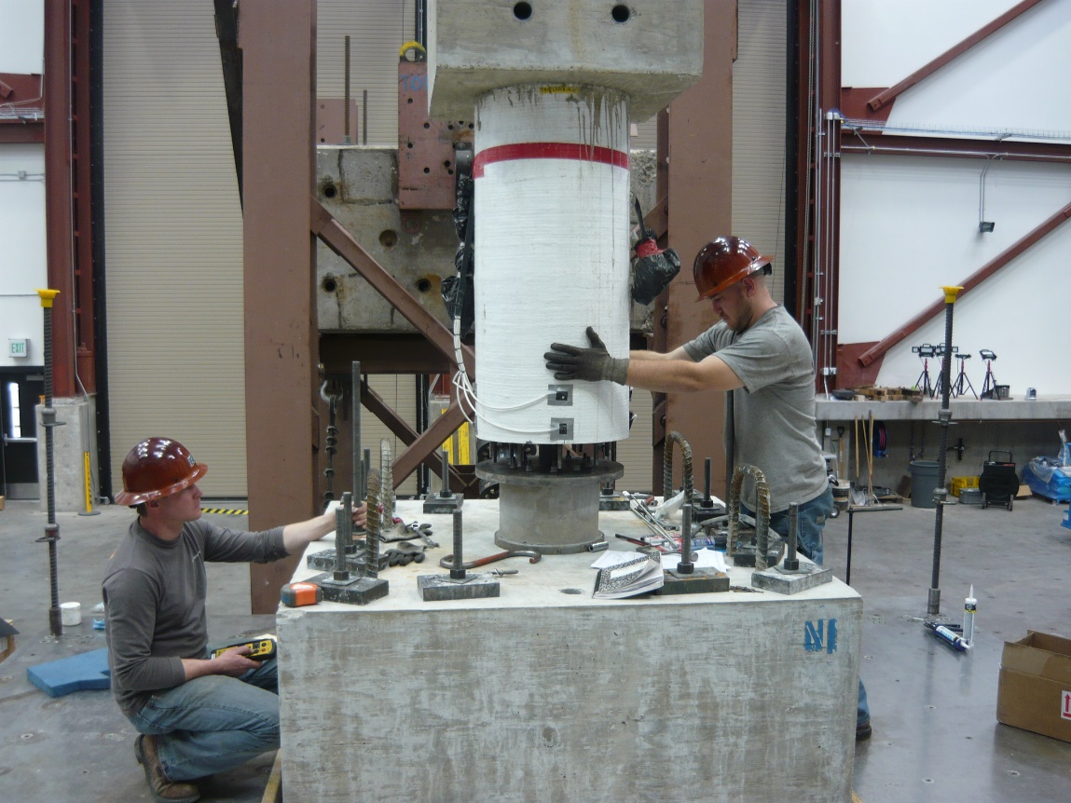
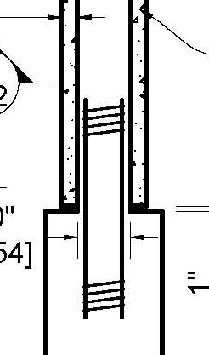
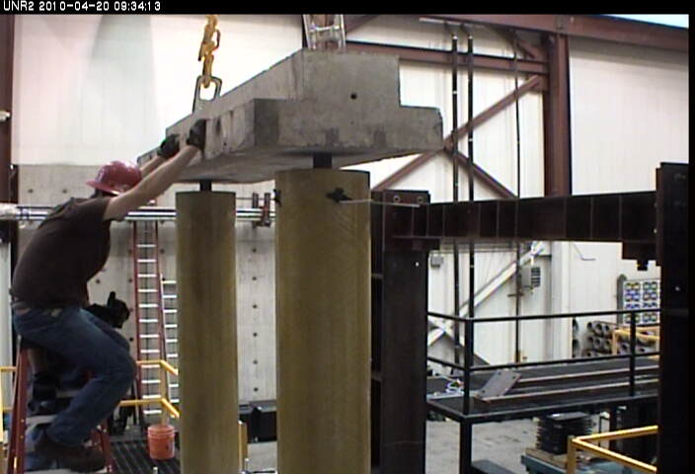
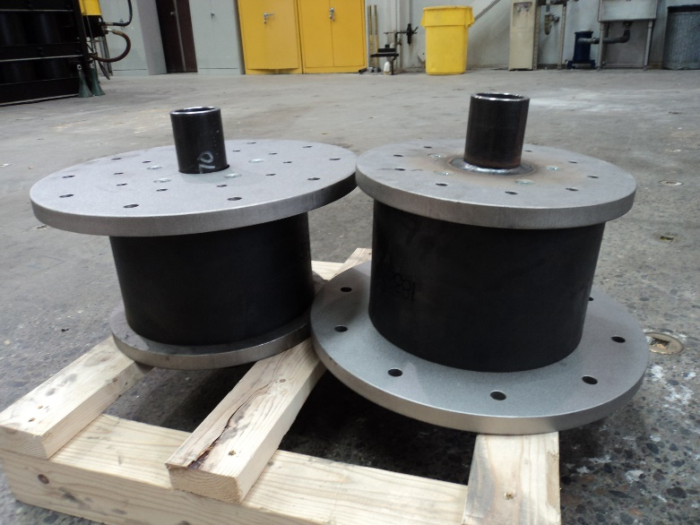
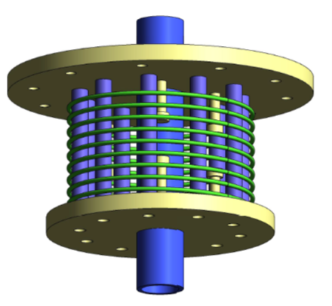
Others
Pins/hinges
Replaceable connections
Etc.
Hinges are common in California and Nevada bridge columns

Slide 12
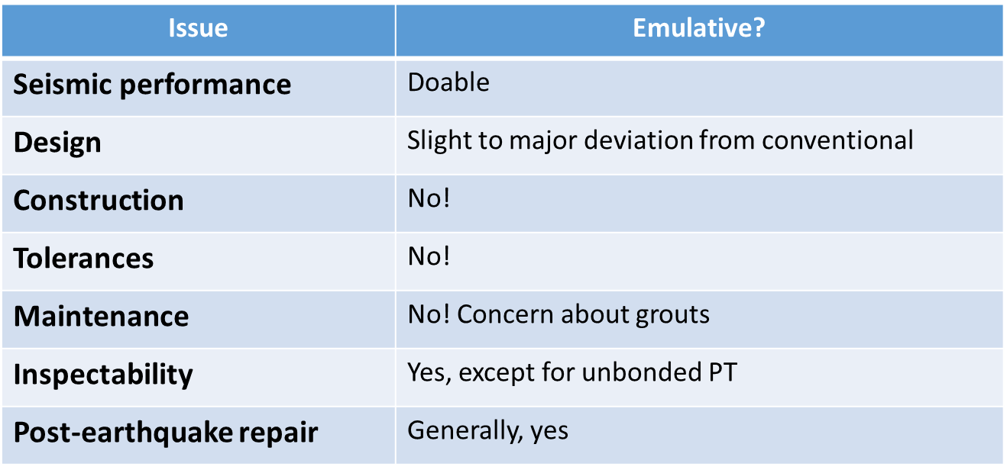
ABC Terminology- “Emulative”

