Slide 1
Introduction to Structural Engineering
Presentation created by David Garber (Assistant Professor, FIU)

Slide 2
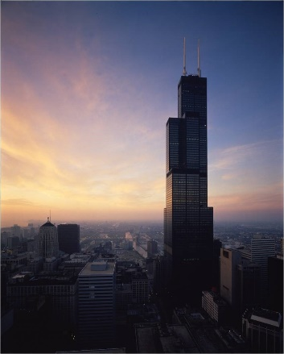
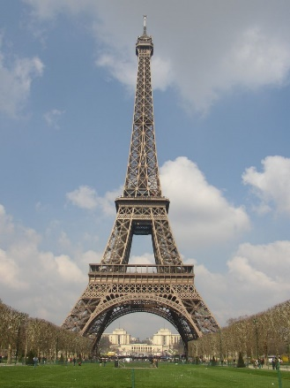
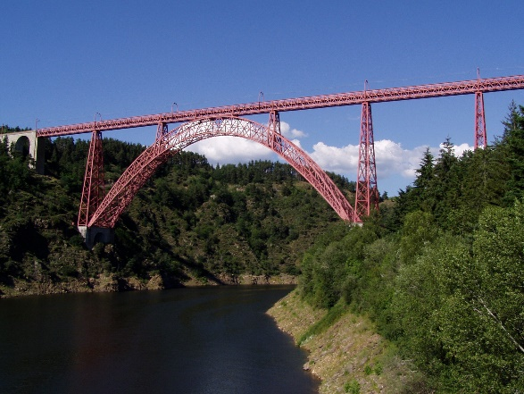
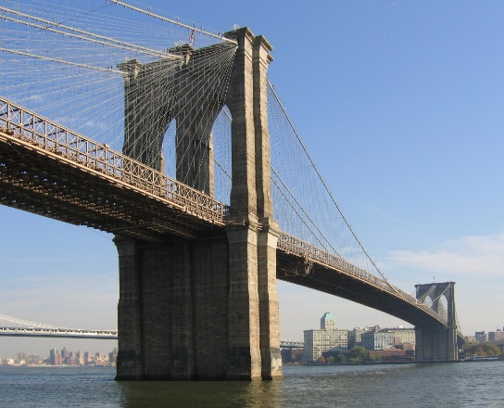
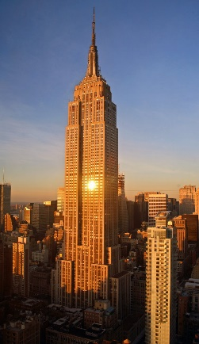
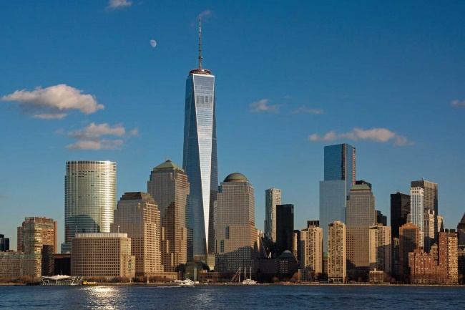
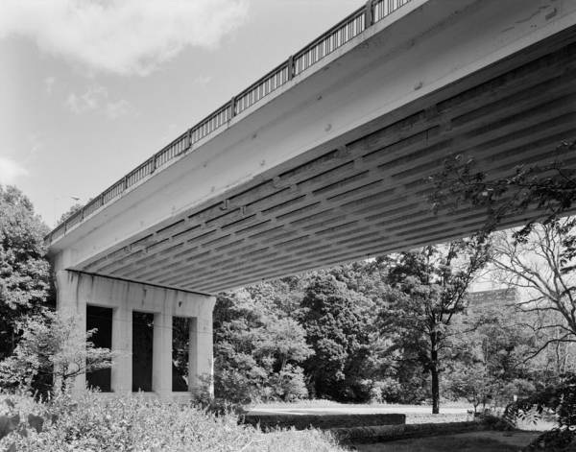
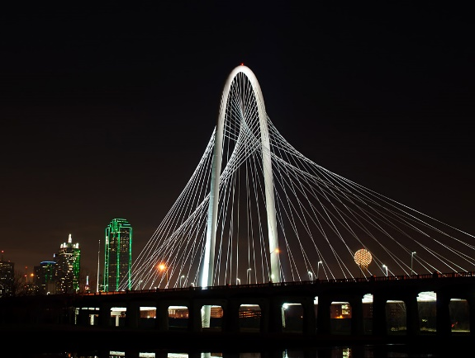
What is Structural Engineering?
Buildings
Bridges
Notes:
Structural engineering mostly deal in the realm of buildings and bridges. They need to understand the forces applied to a structure and how the structure will hold these forces.
Buildings (top right bottom left): Sears Tower (Chicago), Eiffel Tower (Paris), Empire State Building (New York), One World Center (New York)
Bridges (top right to bottom left): Garbit Viaduct (France), Brooklyn Bridge (New York), Walnut Lane Bridge (Philadelphia), Margaret Hunt Hill Bridge (Dallas)

Slide 3
What is Structural Engineering?
What do structural engineers need to consider?
What influences structural engineers?
How is structural engineering poorly defined?
  What are proper definitions and viewpoints?
What will the role of the structural engineer be in the future?
Notes:
The goal of this presentation is to answer several different questions.

Slide 4
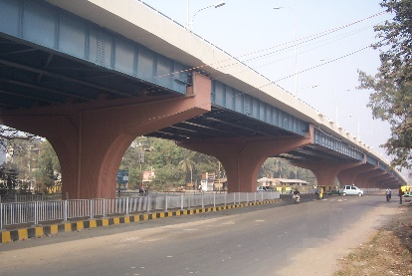
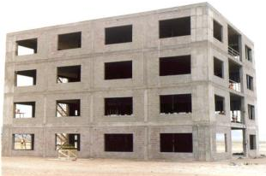
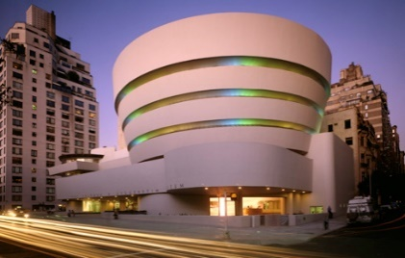

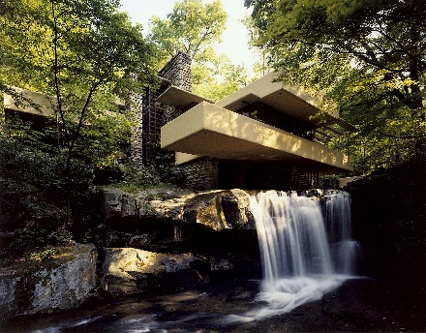
What do Structural Engineers need to consider?
Engineer?
Efficiency
Economy
Who works here?
Architect?
Elegance
SE used to
Notes:
The three area that need to be considered by the structural engineering to ensure a successful design are: Efficiency, Economy, and Elegance. These are well represented by the Venn diagram shown here, which we will keep revisiting in the lecture.
Architect - Frank Lloyd Wright:
“Falling Waters” - Pittsburgh
“Guggenheim Museum” – New York City

Slide 5

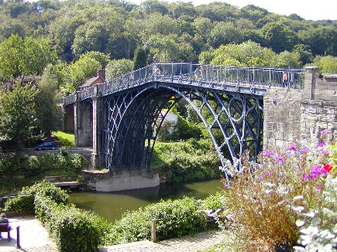
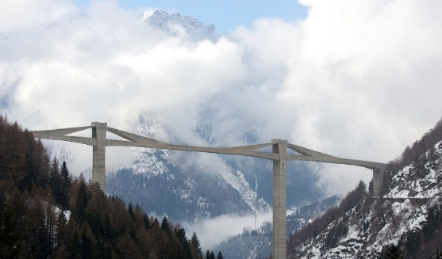
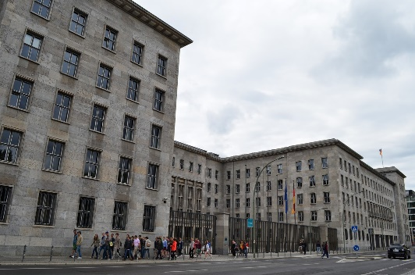
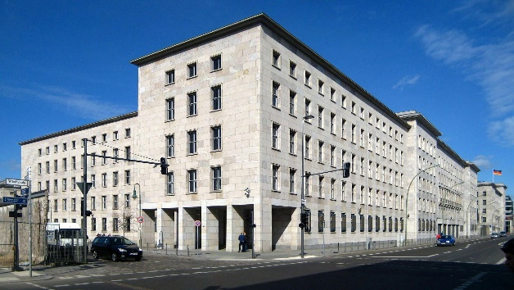
Influences on Structural Design
Steel
Availability and price of materials
Worldviews of time
Iron
Concrete
Ministry of Finance (Berlin, 1936)
Notes:
The engineer has always had to work with the (1) available materials of the time and (2) opinion / worldview of the public.
Available Materials: Iron, stone, and wood were the predominant building materials of the past. Steel and concrete are the predominant materials of the present.
Example of Worldview Effect: The Ministry of Finance building was designed and constructed during the reign of the Nazi party in Germany. The building reflects the utilitarian, mechanistic worldviews of the Nazi party.
These two are competing but complimentary

Slide 6
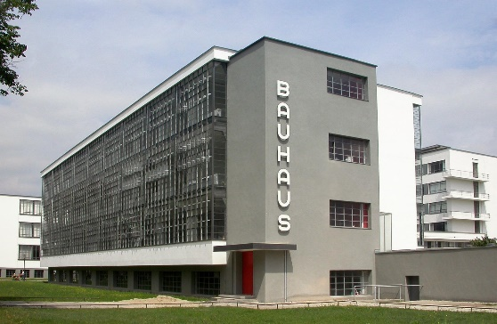
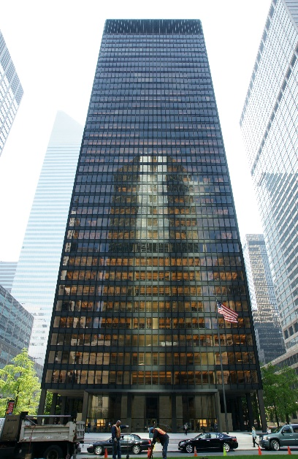
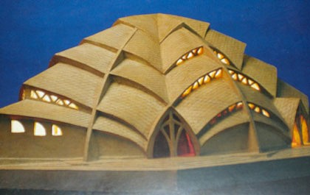
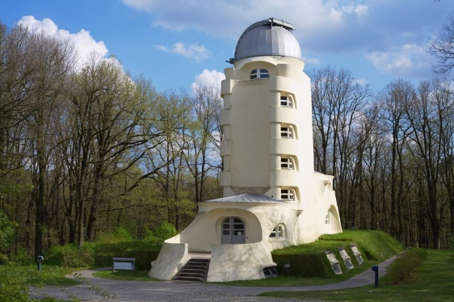
Influence of Worldviews
Further example from the 20th Century
Formalism
Expressionism
mathematically verifiable; mechanical
based on emotions; imaginative
flat roofs, smooth facades, cubist shapes
organic or biomorphic shapes
Notes:
The focus of this talk will be on how materials and loads affect the development of form. However, we will turn quickly and look at a few examples of how worldviews have affected our structures.
Logical positivism (or Formalism) is the idea that every rationally justifiable assertion can be scientifically verified or is capable of logical or mathematical proof. This worldview led to buildings and styles based solely on numbers, measurements, and abstract lines.
Examples: Bauhaus Building (Germany, 1926) and Seagram Building (New York City, 1958)
These designs were popular amongst architects and were even used when inappropriate (where heavy rains or snow loading was prevelant)
Expressionism is seen to function in the imaginative sphere (creative world) and is based on emotional experiences (rather than the outside world). Expressionism produces organic or biomorphic shapes with a sense of movement.
Examples: Sternkirche (model from 1922) and Einstein Tower (Germany, 1922)
These worldviews led to two very different types of structures

Slide 7
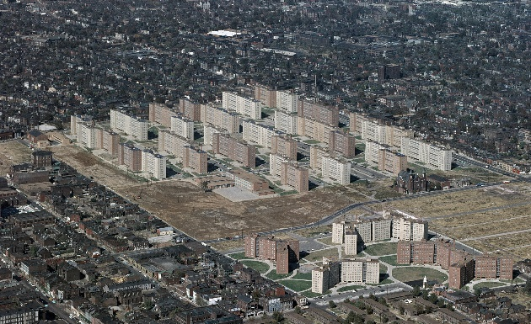
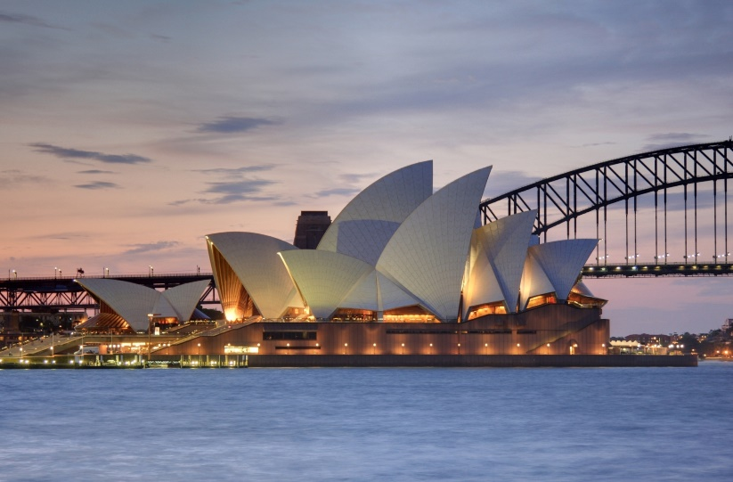
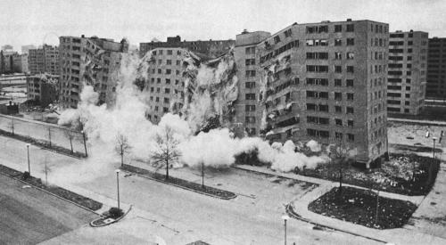
Influence of Worldviews
Problems with building only on worldview
Formalism
Expressionism
Problem: people are more than just machines
Problem: nature doesn’t always agree with your imagination
Notes:
Buildings strongly reflecting the modern worldview were oftentimes not successful; here are two cases:
Example of Formalism forgetting to consider social impacts: The Pruitt-Igoe Housing Development (constructed in St. Louis in 1956) was one of many similar developments that were built in major cities. These projects were created by city planners who treated humans as complex machines who needed to be placed in a neighborhood that served only their mechanical needs. These buildings were quickly seen as high-rise cement prisons and the neighborhoods became seedbeds for crime and social pathology. This development was completed demolished in 1972.
Example of expressionism not considering how nature actually works: The Sydney Opera House was formed based on the ideas of the architect alone (and not on the laws of nature [gravity] and the patterns of society [cost]). The building was an engineering nightmare and ended up costing 20 times the initial estimated cost.

Slide 8
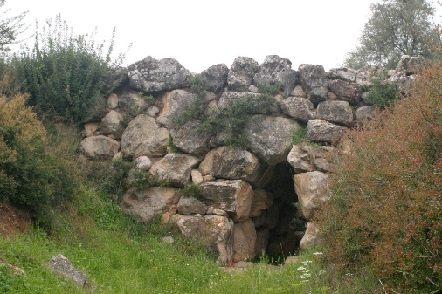
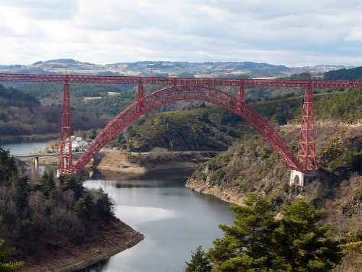

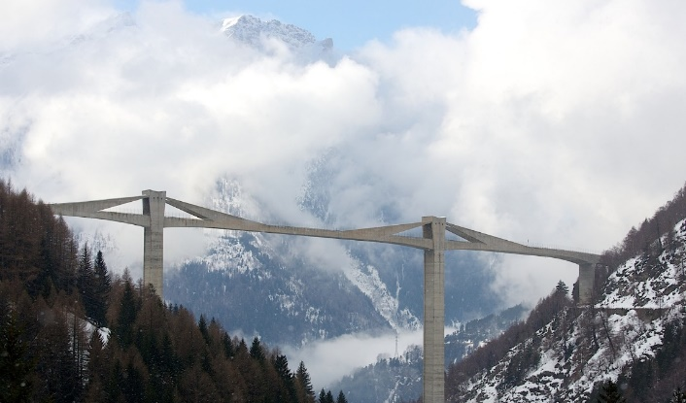
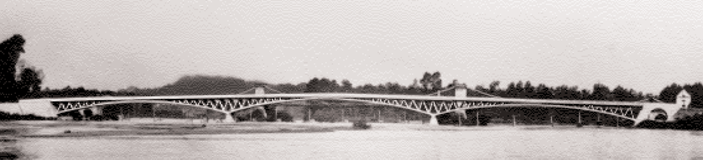
History based on Material Evolution
1300 BC
1889
1951
Timeline
1980
1883
1781
1911
Notes:
We now turn our attention to how the available materials have caused structural shape to evolve over time.
Available materials have changed over time: from stone and wood → iron → concrete and steel
As a new material became available for use, the engineer developed new structural forms to make best use of the materials.
There are many examples of innovative feats of engineering, these are some of the landmark bridges:
Arkadiko Bridge (1300 BC; Argolis, Greece) – corbel arch bridge made of cyclopean stone (still in use as a footbridge today)
Iron Bridge (1781, UK) – world’s first iron bridge
Garabit Viaduct (1885, France) – iron bridge constructed by Gustave Eiffel, reflects the understanding of forces he used to design the Eiffel Tower, incredibly stiff bridge (needed for the rail structure above)
Brooklyn Bridge (1883, New York City) – combination suspension and cable-stayed bridge design by John Roebling (the father of the suspension bridge); first steel-wire suspension bridge constructed
Pont le Veurdre (1911, France) – an early prestressed concrete bridge by Eugene Freyssinet (the father of prestressed concrete)
Walnut Lane Memorial Bridge (1951, Philadelphia) – first prestressed concrete bridge in the US, designed by Gustave Magnel (the father of the modern prestressed concrete bridge), 30% less expensive than a regular concrete arch design
Ganter Bridge (1980, Switzerland) – early extradosed (cable-stayed) concrete bridges by Christian Menn

Slide 9

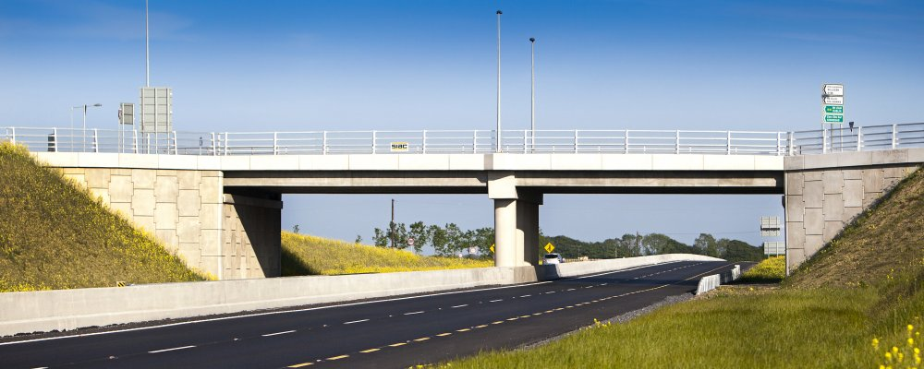
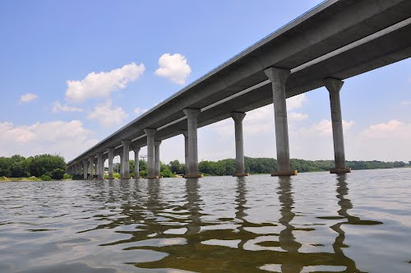
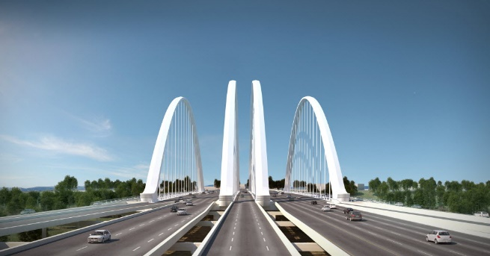
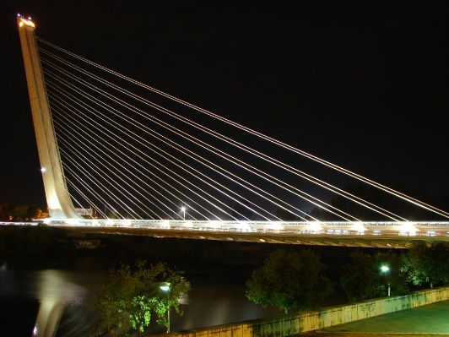
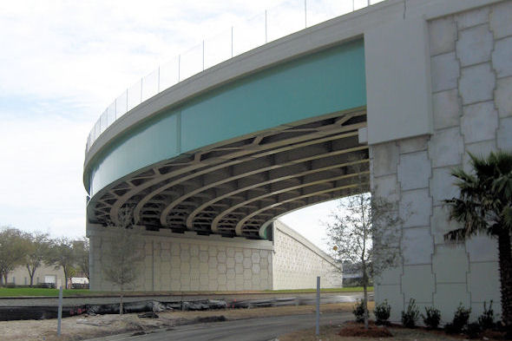
Another Conflict from Modern Day
Elegance
Efficiency
vs.
Notes:
Today, for major projects, the engineer will typically have no say with regard to form (we will touch on this more later). This has led to a modern perspective where elegance and efficiency are at war with each other (the architect versus the engineer).
On the left are three bridges designed by Santiago Calatrava where form may have been overemphasized leading to inefficient designs (from top):
Margaret Hunt Hill Bridge (2012, Dallas)
Margaret McDermott Bridge (TBD, Dallas)
Puente del Alamillo (1992, Spain)
On the right are three types of bridges that are efficiently designed, but may lack elegance (depending on your perspective) (from top):
Prestressed concrete beams
Post-tensioned segmental construction
Curved steel plate girders

Slide 10
What is Structural Art?
Structural Art
What is accomplished in structural art?
Conservation of natural resources
Minimization of public expenditures
Creation of a more visually appealing environment
Efficiency
Economy
Elegance
Engineering Elegance
Notes:
How can a structure once again be both beautiful and efficient/economic? We need to look at the idea of Structural Art.
The disciplines of structural art are efficiency and economy but it must also consider the creation of a more visually appealing environment
Structural art is the idea that engineering (typically seen to lie in the intersection between efficiency and economy) can also be elegant → giving us Engineering Elegance

Slide 11
Engineering and Science
What are engineering and science and how do they relate?
False View
Better View
Nature
Nature
Scientist
Interprets
Creates
Scientist
Engineer
Engineer
Each draws from the other
Notes:
The modern conception is that Engineering cannot be Elegant
The problem with the loss in this concept of Engineering Elegance begins with a few false definitions; first being of engineering and science
False view: “The honor of creative genius and the precedence in innovation belong to the scientist; the engineer is merely the technician, following orders from above.”
Scientist is seen as coming before the engineer
Scientist innovates based on nature and tells the engineer what to do
Led to calling engineering = “Applied Science”
These ideas also led to the creation of the National Science Foundation by President Truman in the 1950’s, which showed the government’s support of “science” and not necessarily engineering.
A better view is shown on the right
Engineering (or technology) is the making of things that did not previously exist
Science is the discovery of things that have long existed
Science and technology are parallel activities
Each one at times draws from the other, but more often they develop independently

Slide 12
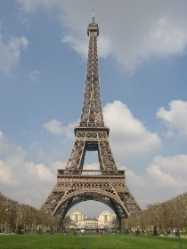


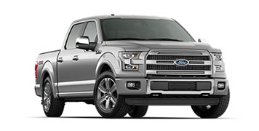
Structures and Machines
Which of these involves technology?
Poor Definition: Technology only involves machines
Better View: Two realms of technology
Structures
Machines
static, local, permanent works
dynamic, universal, transitory
Stand for: continuity, tradition, protection of society
Stand for: change, mobility, risk
Notes:
Another false definition has developed for structures, machines, and technology.
Where is technology involved?
A poor definition to this question is that: Technology only involves machines
With this definition, advances in technology are only made through advances in machines
A better view is that there are two realms of technology: structures and machines
Structures are static, local, permanent works that stand for continuity, tradition, and protection of society
These are two example of structures (from earlier) that have become symbols for their cities and have stood the test of time (Eiffel Tower and Brooklyn Bridge)
Machines are dynamic, universal, transitory works that stand for change, mobility, and risk.
There are many computers and trucks in the world. They are constantly being improved and older models are constantly becoming obsolete.
Technology always involves both structures and machines; both require each other

Slide 13
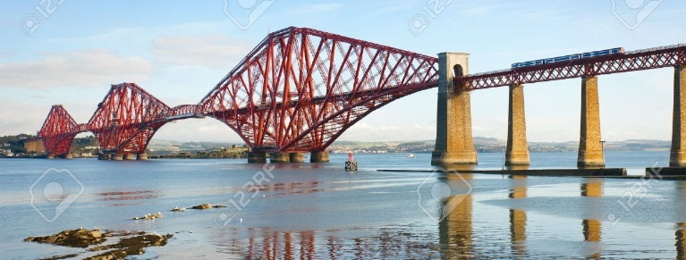
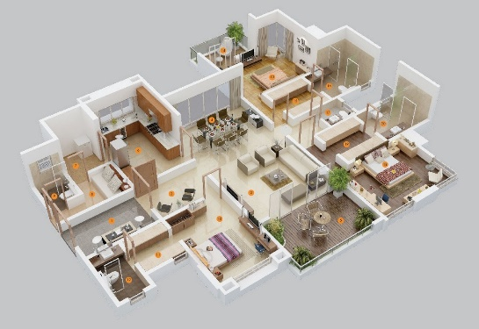
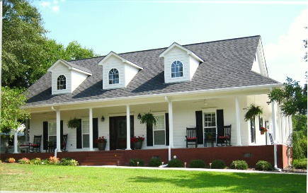
Structures and Architects
What should be the role of the architect?
Poor Definition: “The belief that the happy engineer, like the noble savage, gives us useful things but only the architect can make them into art.”
Better View: Architects and engineers have a different view of form; a different focus
Engineer
Architect
control forces
control spaces
Notes:
Another misconception is found in the perceived difference between (and roles of) the engineer and the architect.
The current belief is that the architect is the only one who can make things attractive and the engineer is only responsible for making whatever the architect designs stand up.
A better view is that architects and engineers have a different view of form, a different focus.
Engineers focus on controlling forces
Architects focus on controlling spaces

Slide 14
Three Dimensions of a Structure
What are the three main dimensions (aspects) of structures?
Structure must perform in accordance with the laws of nature
Structures must be supported by an individual or society
Scientific
Social
Symbolic
Major structures become known by every citizen and become a symbol of city
Notes:
We move from the exploration of the false definitions of the structural engineer to the three dimensions of a structure: Scientific, Social, and Symbolic.
Scientific → Structures must perform in accordance with the laws of nature
Social → Structures must be supported by an individual or society
Symbolic → Major structures become known by every citizen and become a symbol of a city or country
Symbolic:
“It so happens that the work which is likely to be our most durable monument, and to convey some knowledge of us to the most remote posterity, is a work of bare utility; not a shrine, not a fortress, not a palace but a bridge. This is in itself characteristic of our time.”

Slide 15
Three Dimensions of a Structure
Performance Metric
Scientific
Social
Efficiency
Economy
Symbolic
Evaluated based on
Elegance
Notes:
The performance metrics of these dimensions are the considerations of a structural engineer that we introduced earlier

Slide 16
Three Dimensions of a Structure
What types of designers work with form in space?
Engineer
Architect
Sculptor
Notes:
There are three different types of designers that focus their efforts on one of these dimensions

Slide 17
Three Dimensions of a Structure
What is the focus of each of these designers?
Engineer
Architect
Scientific
Social
Note: Each designer must not neglect the other two criteria
Symbolic
Sculptor
Notes:
While each designer focuses on one dimension, they cannot neglect the other two.
For example: a sculptor can make a statue, but it needs to stand up (scientific) and someone needs to pay for it (social)

Slide 18
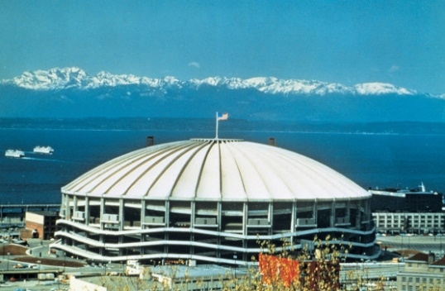
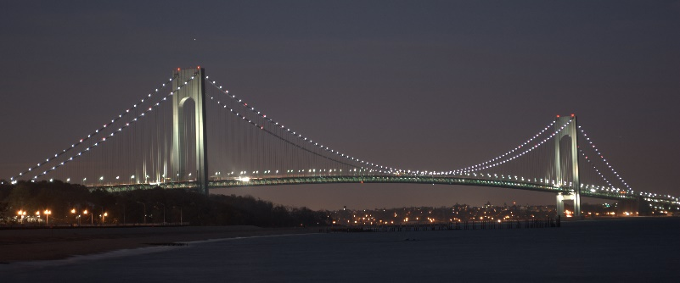
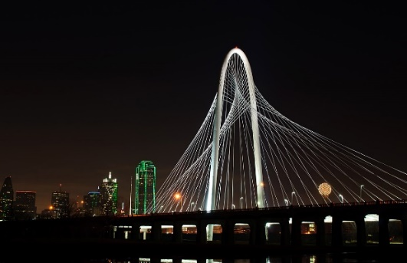
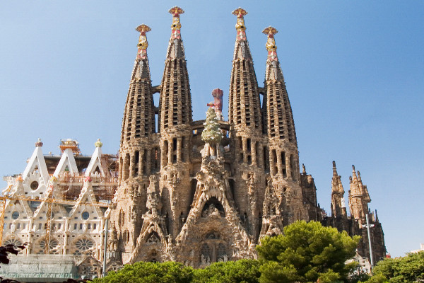
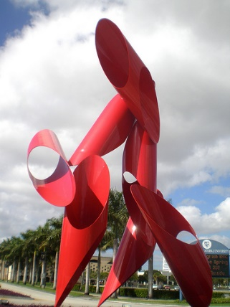
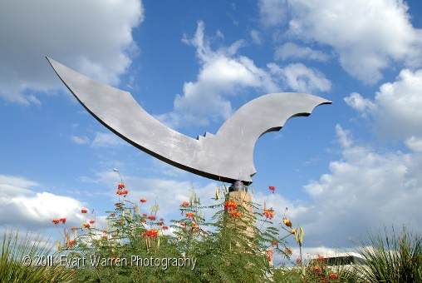
Three Dimensions of a Structure
What types of designers work with form in space?
Engineer
Architect
Sculptor
Notes:
All of these designers work with form and space, but with different emphases
Engineer → focuses on scientific criteria (how can control forces)
Kingdome (1976, Seattle) and Verrazano-Narrows Bridge (1964, New York City)
Architect → focuses on the social dimension (how can this be most useful to society; how can it be supported by society)
Margaret Hunt Hill Bridge (2012, Dallas)
Idea of the “signature bridge” and the support of the community
Sagrada Familia (construction began in 1882, Barcelona, designed by Antonio Gaudi)
Relied entirely on private donations for funding (ensuring community support)
Sculptor → focuses on symbolic dimension (how can it be most elegant or powerful)
“Argosa” in FIU Margulies Sculpture Park is one of the iconic sculptures in FIU’s sculpture garden
“Nightwing” in Austin, TX → symbol for the 1.5 million bats that live under the Congress Avenue Bridge in downtown Austin

Slide 19

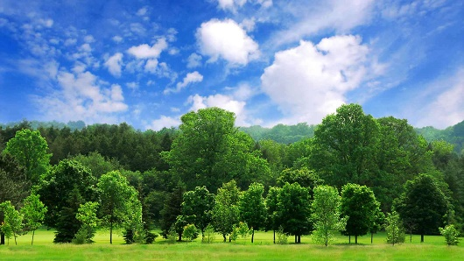
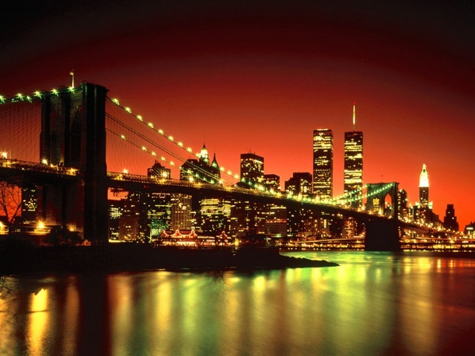
Structural Art and Society
What are the ideals of an urban society?
Conserve natural resources
Minimize public spending
Create more visually appealing environment
Notes:
The ideals of an urban society (shown) also align with the dimensions of a structure and the considerations of a structural engineer
But if the ideals of an urban society are this closely aligned with the objectives for the engineer, why is there such a disconnect between the public, owner, architect, and engineer?

Slide 20


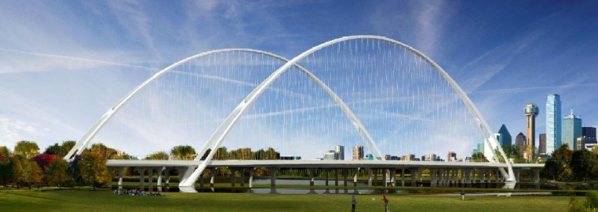
Structural Art and Society
Main Problems
Engineer no longer develops form
Trinity River Bridges, Dallas
Public no longer has an input
Notes:
There are two main reasons that there is such a breakdown in the modern (US) system:
Engineers no longer develop form
The public no longer has an input in the process
Example of engineers no longer developing form: Trinity River Bridges → These bridges were primarily designed by an architect and the project is way over budget and far behind schedule

Slide 21
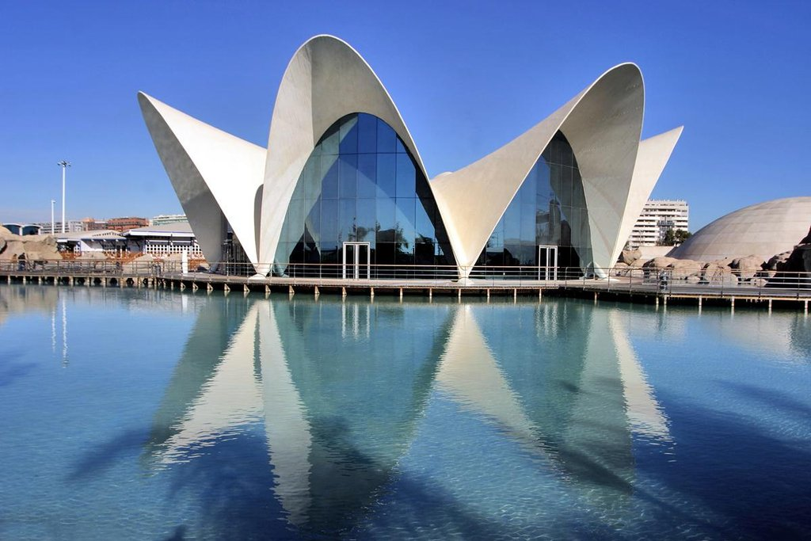
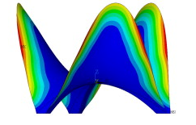
Structural Art and Society
Why should the engineer have a say?
Form controls Forces
Forces control form
Notes:
Engineers should still play a large role in the selection of form because:
Form controls forces and
Forces control form
The L’Oceanographic (2003; Valencia, Spain) is an example of a well engineered structure where its form closely follows the forces and stresses. This structure has a similar shape to the Sydney Opera House, but it was much more constructible and much less expensive.

Slide 22
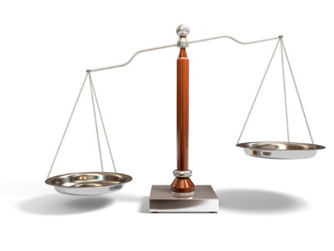
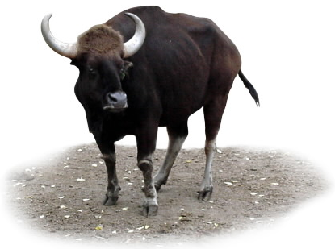

Structural Art and Society
Why should the public have a say?
Francis Galton and the 1906 Plymouth County Fair
Actual Weight:
1,198 lbs.
Average of Crowd:
1,197 lbs.
Under the right circumstances, groups are remarkably intelligent, and are often smarter than the smartest people in them
Crowdsourcing
Notes:
The public should also still have more of a say in what structures are built and how they are built.
An example of the wisdom of crowds can be seen by Francis Galton’s ox weight experiment of 1906.
Galton conducted his experiment at a county fair in rural England. He set up a weight-judging competition where a fat ox had been selected and placed on display. People could pay sixpence to see if they could make the best guess at the ox’s weight; the closest to the weight receiving a prize.
Eight hundred people (with a diverse background) gave their guess at the ox’s weight
Many of them were butchers and farmers who would have had a good gauge on the cows weight
Many of them came in from the city and would have had no prior knowledge of cattle
At the end of the day, Galton gathered all the guesses and found their average. The average weight guessed was 1,197 lbs. and the actual weight was 1,198 lbs.
Galton showed that under the right circumstances, groups are remarkably intelligent, and are often smarter than the smartest people in them
This is the premise behind the stock market (a group of people with a vested interest can best gauge the actual value of a company) and should be extended to structural engineering.

Slide 23
Structural Art and Society
What are possible solutions?
Public Design Competition (Switzerland)
Bridge is desired, project announced
Engineers develop preliminary forms and prices
Informed public (both experts and general) decide on the project to be built
Notes:
One solution that both gives structural engineers the opportunity to develop form and allows the public the opportunity to weigh in on the selection of a bridge is the Public Design Competition in Switzerland.
(process is shown on slide)

Slide 24
Structural Art and Society
Tradition of Swiss Bridge Engineers
Robert Maillart
Othmar Ammann
Christian Menn
Notes:
The success of the Public Design Competition in Switzerland can be seen in some of famous structural engineers that have come from Switzerland:
Robert Maillart (1872 – 1940)
Othmar Amman (1879 – 1965)
Christian Menn (1927 – present)

Slide 25


Structural Art and Society
Tradition of Swiss Bridge Engineers
Robert Maillart
Othmar Ammann
Christian Menn
Notes:
Robert Maillart was one of the fathers of modern-day prestressed concrete bridges
Two of his most elegant reinforced and prestressed concrete arch bridges are:
Salginatobel Bridge, Switzerland (1931) (left)
Schwandbach Bridge, Switzerland (1933) (right)

Slide 26



Structural Art and Society
Tradition of Swiss Bridge Engineers
Robert Maillart
Othmar Ammann
Christian Menn
Notes:
Othmar Ammann is the father of the modern suspension bridge
George Washington Bridge, New York City (1931) (left)
Verrazano-Narrows Bridge, New York City (1964) (bottom right)
He also worked on other beautiful projects, such as the Bayonne Bridge, New York City (1931) (top right)

Slide 27



Structural Art and Society
Tradition of Swiss Bridge Engineers
Robert Maillart
Othmar Ammann
Christian Menn
Notes:
Christian Menn is one of the last structural artists. He has worked on a number of bridges in both Switzerland and the US, including:
Ganter Bridge, Switzerland (1980) (top left)
Sunniberg Bridge, Switzerland (1998) (bottom left)
Leonard P. Zakim Bunker Hill Memorial Bridge, Boston (2003) (right)

Slide 28
Future of Structural Engineering
What will our role be in the future?
New Technologies
New Societal Demands
New Definitions of Beauty
Notes:
Next we turn to the future of structural engineering. As with all our discussion so far, we can represent the future of structural engineering in our Venn diagram
The future of structural engineering will be determined by:
New Technologies (allowing for reexamining our scientific/efficient dimension)
New Social Demands
New Definitions of Beauty

Slide 29






Future of Structural Engineering
What will our role be in the future?
Iron
THEN
New Technologies
New Societal Demands
Steel
NOW
New Definitions of Beauty
Concrete
FRP
UHPC
FUTURE
CNT
Notes:
Several new materials have been discovered in the past few decades and are becoming more available for use by structural engineers. These include:
Fiber reinforced polymers (FRP)
Carbon nanotubes (CNT)
Ultra-High Performance Concrete (UHPC)
These new materials will allow structural engineers to explore new, more efficient, elegance, and economic forms

Slide 30



Future of Structural Engineering
What will our role be in the future?
Faster Construction
New Technologies
New Societal Demands
New Definitions of Beauty
Accelerated Bridge Construction (ABC)
Notes:
The future will also bring new societal demands. One of these is a need for faster construction.
Bridge construction and construction zones cause delays and also are the cause for hundreds of deaths each year.
In order to decrease the time that the public is impacted by work zones, accelerated bridge construction (ABC) is a larger demand.
Furthering the development of ABC techniques and technologies is one of the main objectives of the Accelerate Bridge Construction University Transportation Center (ABC-UTC) led by Florida International University.
ABC will likely become standard practice in the coming years.

Slide 31



Future of Structural Engineering
What will our role be in the future?
New Technologies
New Societal Demands
New Definitions of Beauty
Notes:
Society will continually be redefining beauty as well.
Birj Khalifa – Dubai, 2009 (top left)
One World Trade Center – New York City, 2013 (top right)
University of Limerick: Living Bridge – Ireland, 2007 (bottom right)

Slide 32
Future of Structural Engineering
What will our role be in the future?
Notes:
All this being said, the future of structural engineering will depend on the future generation of structural engineers. YOU!
You can help to decide what our future structures will look like and what the role of a structural engineer will be.

Slide 33



References / Further Reading
Crowdsourcing
Perspective on the Evolution of Structures
Art and Worldview
Notes:
Much of the material for this presentation was developed based on the book “The Tower and the Bridge” by David Billington. This would be a good resource for further reading on structural engineering.

Slide 34


Structural Engineering Activities
Thin-Plate Bridge
Two Scales, One Beam, and a Weight
?
Notes:
As we saw, structural engineers are largely concerned with how a structure carries load. These two activities will allow you to further explore load carrying and load path.
Thin-Plate Bridge: The focus of this activity is to see how structural shape can influence strength. See the activity sheet for more information.
Two-Scales, One Beam, and a Weight: The focus of this activity is to see how load is carried through the beam to the supports and into the ground, which shows load path. See the activity sheet for more information.

Slide 35
Thank You
Presentation Created by: David Garber, PhD (dgarber@fiu.edu)
Assistant Professor, Florida International University

