Slide 1
Introduction to Bridge Engineering
Presentation created by David Garber (Assistant Professor, FIU)

Slide 2
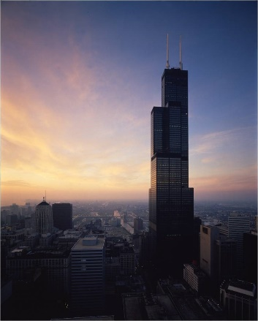
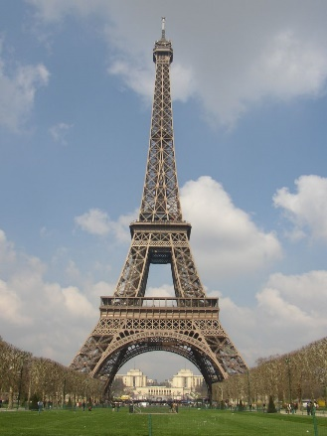
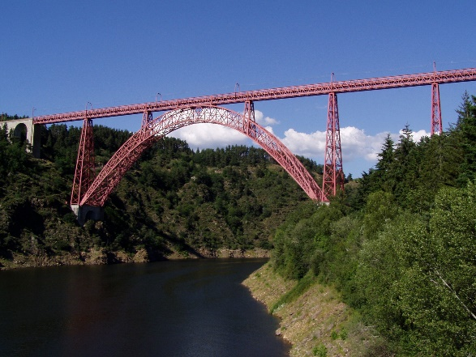
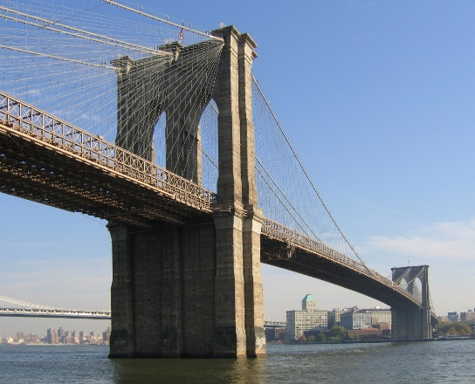
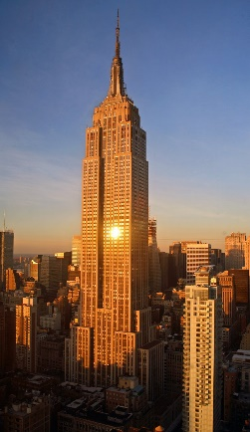
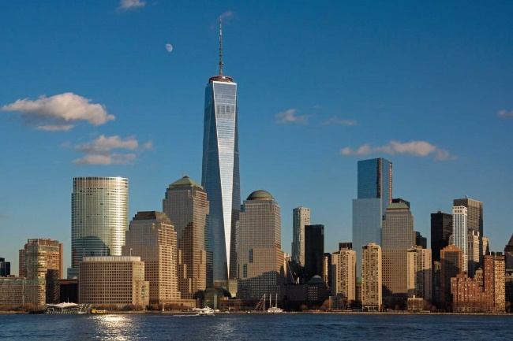
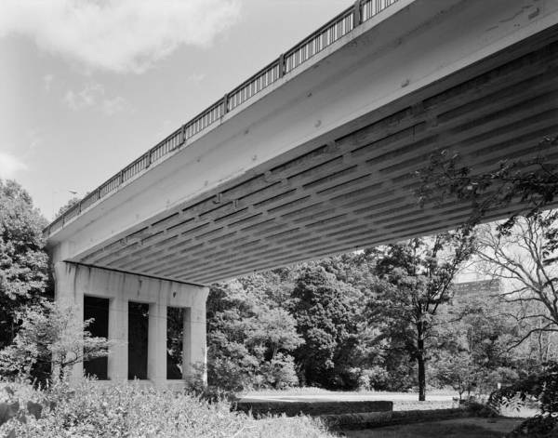

What is Structural Engineering?
Buildings
Bridges
Notes:
Structural engineering mostly deal in the realm of buildings and bridges. They need to understand the forces applied to a structure and how the structure will hold these forces.
Buildings (top right bottom left): Sears Tower (Chicago), Eiffel Tower (Paris), Empire State Building (New York), One World Center (New York)
Bridges (top right to bottom left): Garbit Viaduct (France), Brooklyn Bridge (New York), Walnut Lane Bridge (Philadelphia), Margaret Hunt Hill Bridge (Dallas)
The focus of this presentation will be on the bridge side of structural engineering

Slide 3
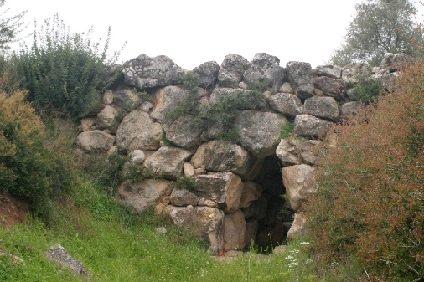
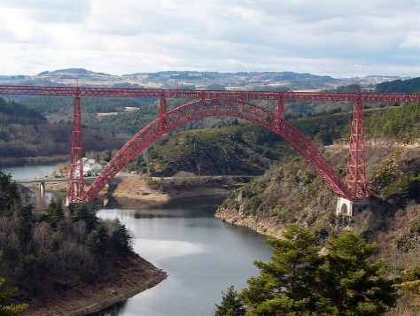

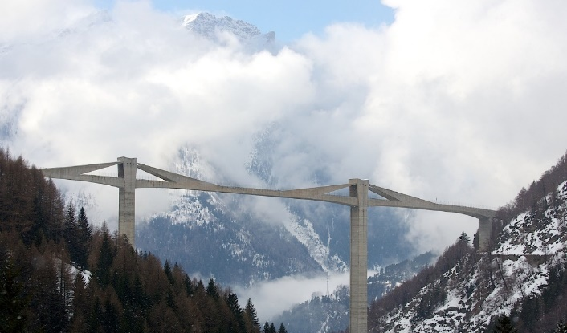
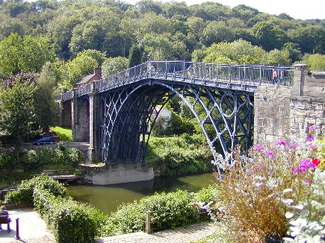

A History of Bridge Engineering
1300 BC
1889
1951
Timeline
1980
1883
1781
1911
Notes:
The availability of materials has caused structural shape to evolve over time.
Available materials have changed over time: from stone and wood → iron → concrete and steel
As a new material became available for use, the engineer developed new structural forms to make best use of the materials.
There are many examples of innovative feats of engineering, these are some of the landmark bridges:
Arkadiko Bridge (1300 BC; Argolis, Greece) – corbel arch bridge made of cyclopean stone (still in use as a footbridge today)
Iron Bridge (1781, UK) – world’s first iron bridge
Garabit Viaduct (1885, France) – iron bridge constructed by Gustave Eiffel, reflects the understanding of forces he used to design the Eiffel Tower, incredibly stiff bridge (needed for the rail structure above)
Brooklyn Bridge (1883, New York City) – combination suspension and cable-stayed bridge design by John Roebling (the father of the suspension bridge); first steel-wire suspension bridge constructed
Pont le Veurdre (1911, France) – an early prestressed concrete bridge by Eugene Freyssinet (the father of prestressed concrete)
Walnut Lane Memorial Bridge (1951, Philadelphia) – first prestressed concrete bridge in the US, designed by Gustave Magnel (the father of the modern prestressed concrete bridge), 30% less expensive than a regular concrete arch design
Ganter Bridge (1980, Switzerland) – early extradosed (cable-stayed) concrete bridges by Christian Menn

Slide 4


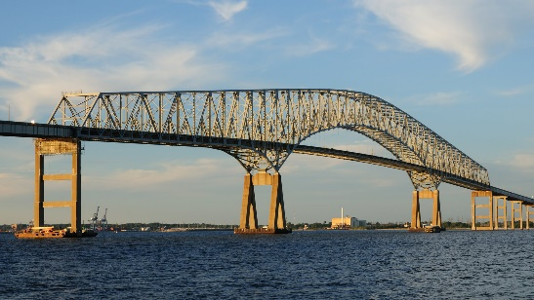
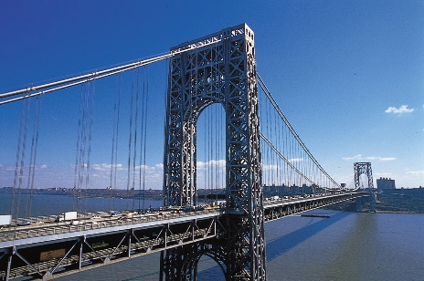
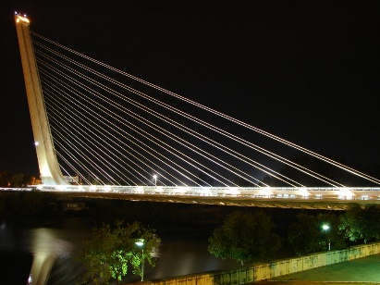
Types of Bridges
Arch
Suspension / Cable Stayed
Girder
Garabit Viaduct
By Gustave Eiffel
Brooklyn Bridge
By John Roebling
Walnut Lane Memorial Bridge
By Gustave Magnel
Truss
Suspension
Cable Stayed
Francis Scott Key Bridge
J.E. Greiner Co., Inc.
George Washington Bridge
By Othmar Amman
Puente del Alamillo
By Santiago Calatrava
Notes:
The variety in available materials and their respective properties has also led to a number of different types of bridge shapes. The ones shown in this slide are a sample of some of the more prevalent types that are used in bridge engineering.
(before moving to the next slide, see if students can draw the path of the load for each of the bridge types)

Slide 5
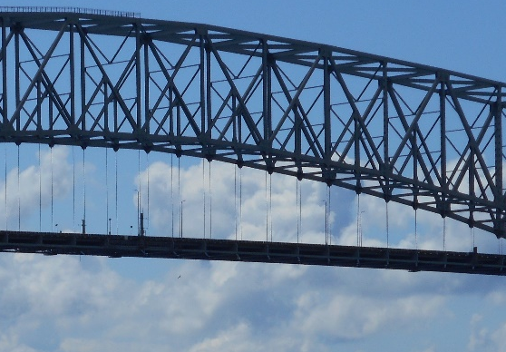
Types of Bridges
Arch
Suspension / Cable Stayed
Girder
Garabit Viaduct
By Gustave Eiffel
Brooklyn Bridge
By John Roebling
Walnut Lane Memorial Bridge
By Gustave Magnel
Truss
Suspension
Cable Stayed
Francis Scott Key Bridge
J.E. Greiner Co., Inc.
George Washington Bridge
By Othmar Amman
Puente del Alamillo
By Santiago Calatrava
Notes:
Each type of bridge carries load differently. The load or force paths for each of these bridge types is shown on this slide (with red = tension force and blue = compression force for the applied load = orange).

Slide 6
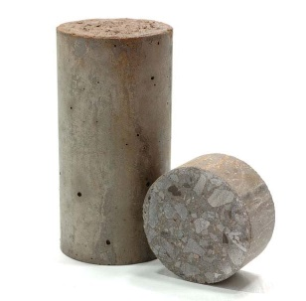
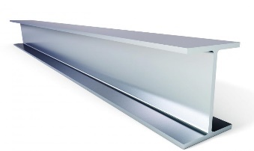
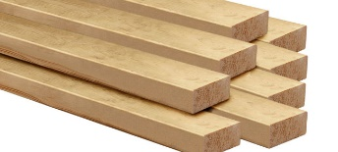

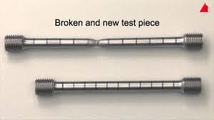
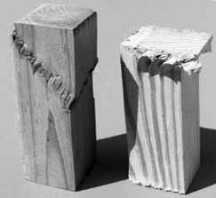
Selection of Bridge Type
Concrete
Available Materials
Steel
Wood
Concrete
Steel
Wood
Good in compression
Brittle failure mechanism
Requires steel to resist tension
Relatively inexpensive
Good in tension
May buckle in compression
Ductile material
Expensive
Notes:
The selection of bridge type is dependent on many different factors. One of the factors is the availability (or choice) of materials.
The majority of modern bridges are made out of either steel or reinforced or prestressed concrete (although there are some wood bridges still being constructed).
Each material has different properties, and thus has different benefits and weaknesses.
Concrete is generally strong in compression, weak in tension, relatively inexpensive, and generally brittle
Video shows a prestressed concrete beam failing in shear → brittle failure
Steel is good in compression, may buckle in tension, is relatively ductile, and expensive.
Wood is weaker than steel, but has similar characteristics otherwise. The behavior of wood is also heavily dependent on grain orientation.

Slide 7
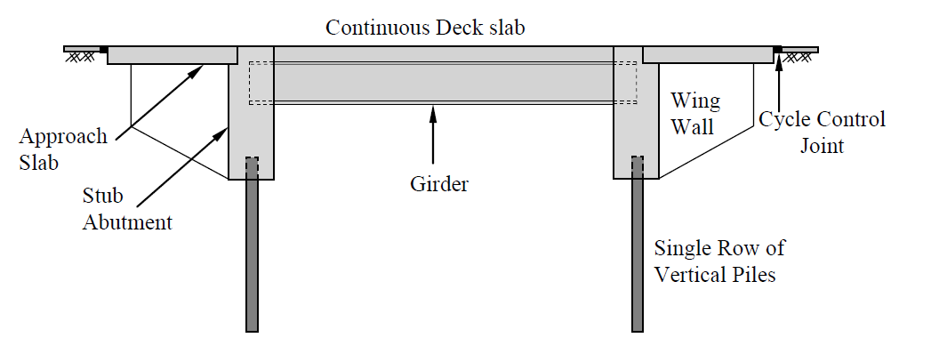
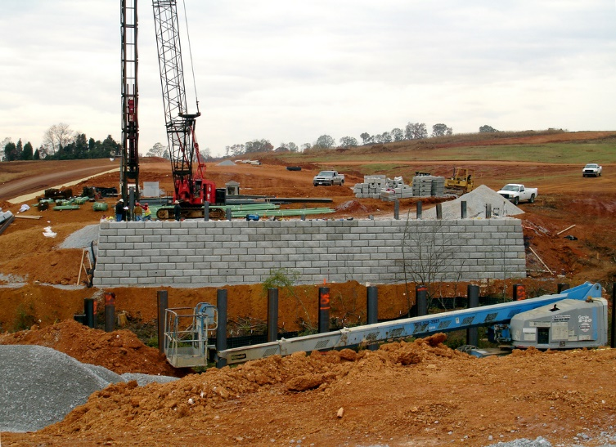
Selection of Bridge Type
Available Materials (concrete, steel, wood, etc.)
Support Conditions and Span Details
Notes:
Bridge engineers must also consider the support conditions and locations and the span lengths and characteristics. Different bridge types are more appropriate for different span lengths and foundations.

Slide 8
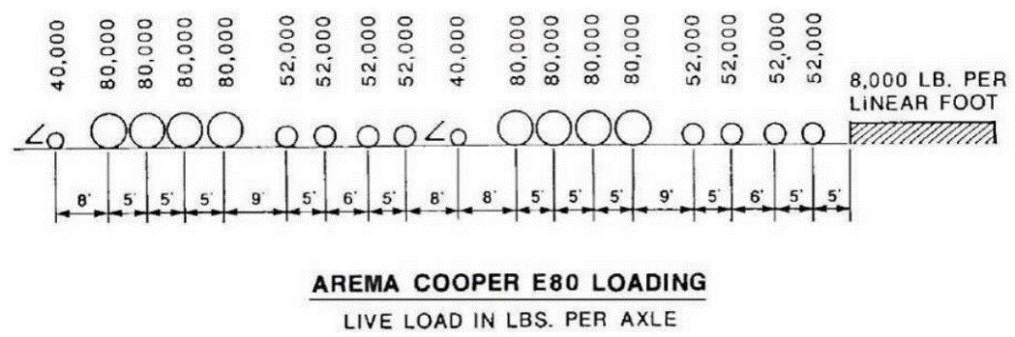
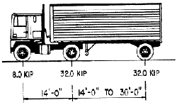
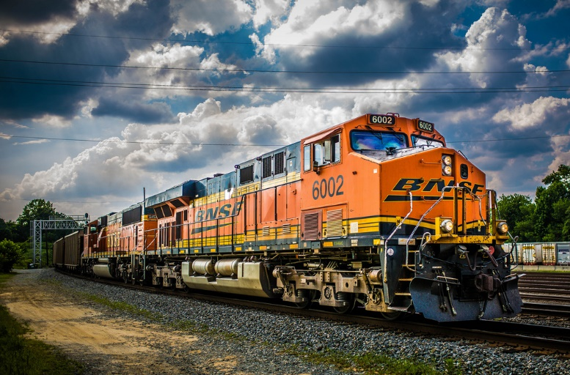
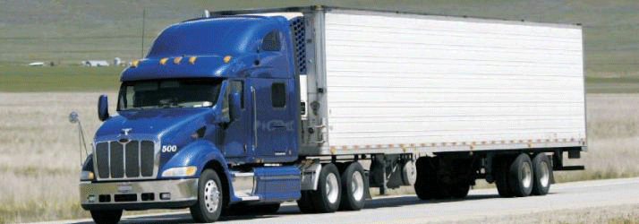
Selection of Bridge Type
Available Materials (concrete, steel, wood, etc.)
Support Conditions and Span Details
Type of Load
Notes:
Bridges will generally carry pedestrians, traffic (cars and trucks), or trains. Each type of load will affect a bridge differently. Additionally, trains generally require bridges to be stiffer.

Slide 9
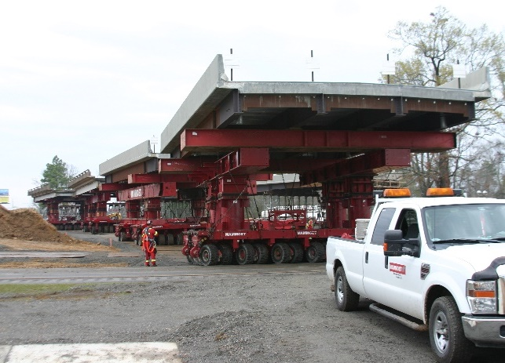
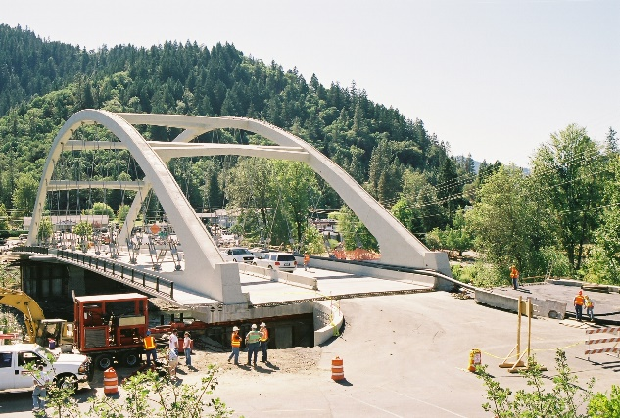
Selection of Bridge Type
Available Materials (concrete, steel, wood, etc.)
Support Conditions and Span Details
Type of Load
Other Considerations → Construction Limitations
Limited Time Window → Accelerated Bridge Construction
Notes:
There are also many other factors that a bridge engineer must take into consideration.
One of these that is becoming more a major factor is limited time windows. Many in-service bridges require fast replacement with minimal disruption to traffic. For these projects, Accelerate Bridge Construction (ABC) is a must.
The next few slides will introduce you to Accelerated Bridge Construction.

Slide 10
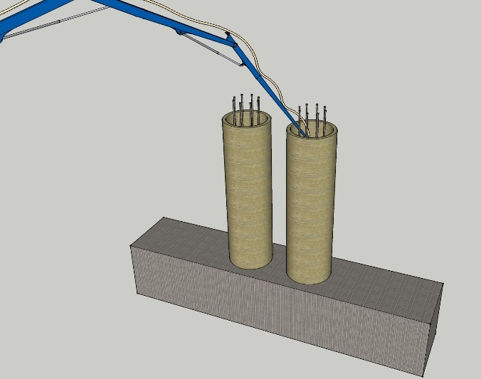
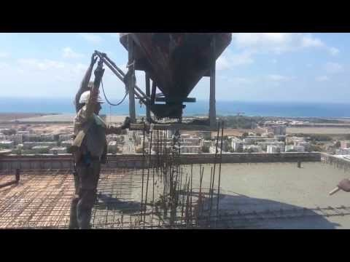
Bridge Construction Method: Cast-in-Place
Cast-In-Place Concrete Construction
Notes:
There are several different types of construction methods. All construction methods do require members to either be constructed at the bridge site or prefabricated off site.
Reinforced concrete bridges can be cast in place. Cast-in-place construction requires reinforcement to be properly placed, formwork to be set up, and concrete to be placed all at the location of the final bridge.
The amount of time that traffic is impacted by construction is significantly larger for cast-in-place (compared to prefabricated).
VIDEO – shows cast-in-place concrete construction of a slab. The process would be similar for bridge construction.

Slide 11
Bridge Construction Method: Prefabrication
Prefabrication
Notes:
Prefabricated construction will result in shorter construction times and better quality control.
This video is from the Precast / Prestressed Concrete Institute and shows the prefabrications process for prestressed concrete products.
The process shown in this video can be used for any component of a bridge (e.g. piles, pile caps, abutments, columns, pier caps, beams, decks, parapets, etc.).

Slide 12
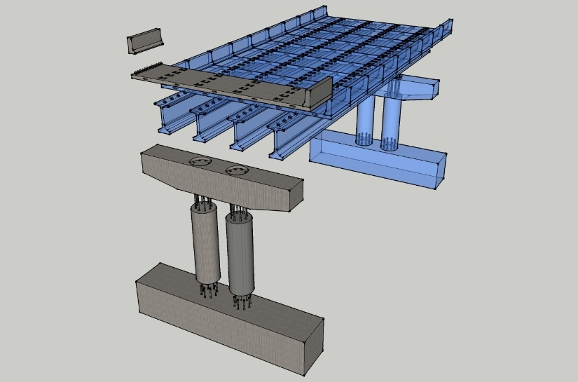
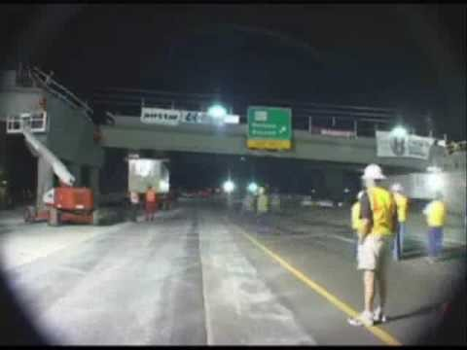
Bridge Construction Method: Prefabrication
Prefabrication
Notes:
All components of a bridge can be prefabricated. The entire bridge span can also be constructed off-site and then driven into place (using technology to be introduces later).

Slide 13

Accelerated Bridge Construction
Major components to bridge construction
  Substructure
    Retaining walls
    Foundations
    Columns systems
  Superstructure
    Beams
    Deck
    Parapets
Notes:
The next few slides will look at how members can be either conventionally constructed or prefabricated.
Note that prefabricated elements need to be connected together at the bridge site. These connections can be difficult and are currently major area of research.

Slide 14
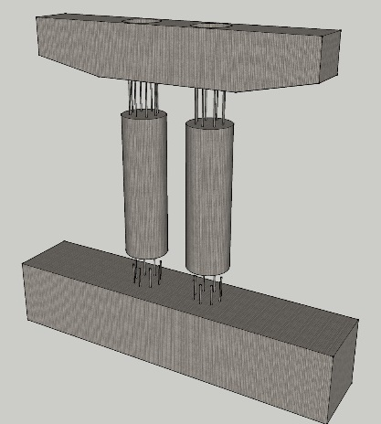
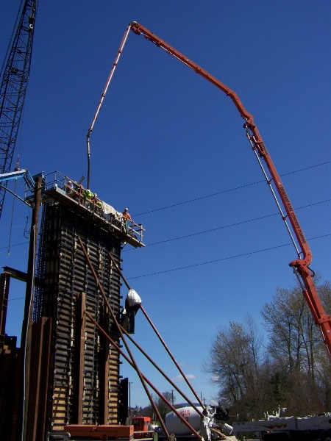
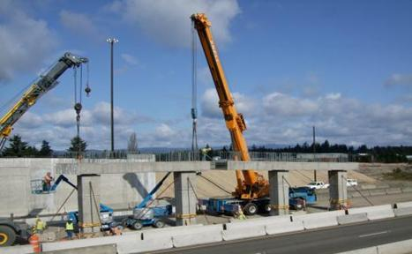
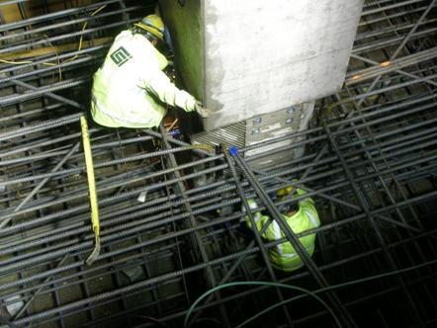
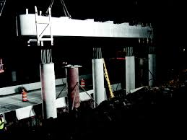
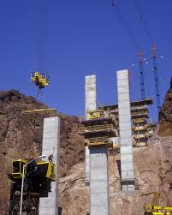
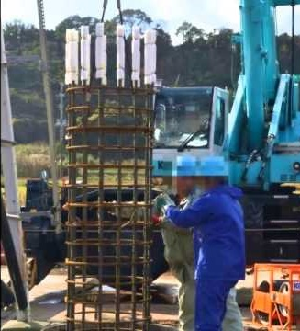
Columns and Bent Caps
Accelerated
Conventional
Notes:
Both columns and bent caps can be prefabricated. Prefabricated columns can both speed up construction and allow for patterns and architectural finished to increase the aesthetics of a bridge.
Satisfactory connections between columns and adjacent members can be achieved using ultra-high performance concrete (UHPC)

Slide 15
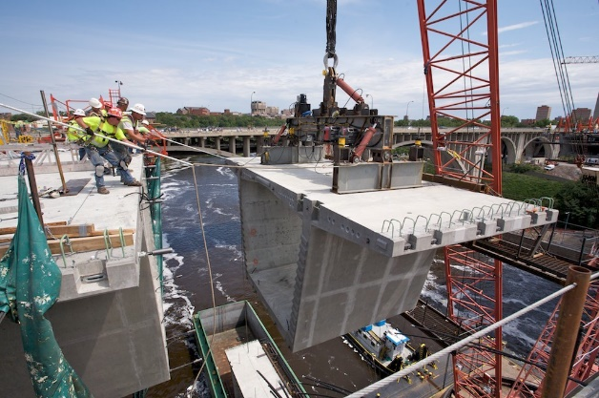
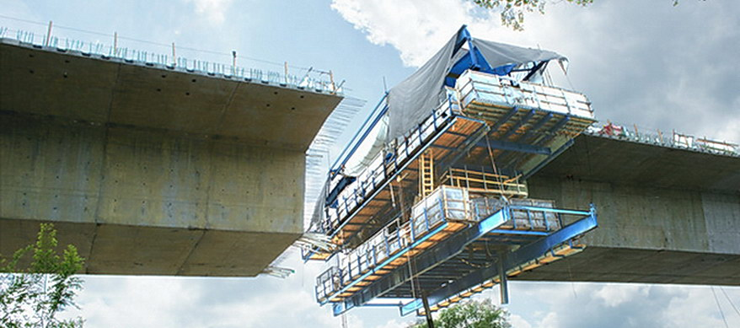
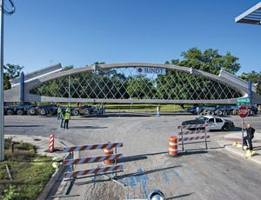
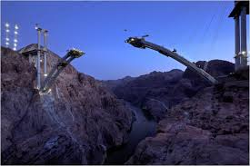
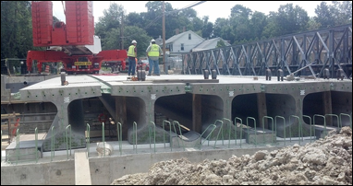
Girders and Superstructure
Accelerated
Conventional
Notes:
Girders and other superstructure elements can also be prefabricated. Conventional construction is rarely used for these elements in modern construction.

Slide 16
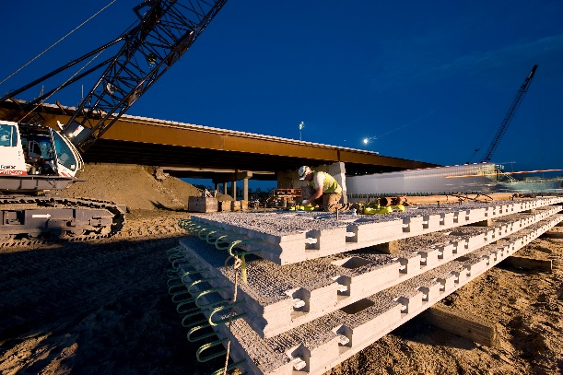
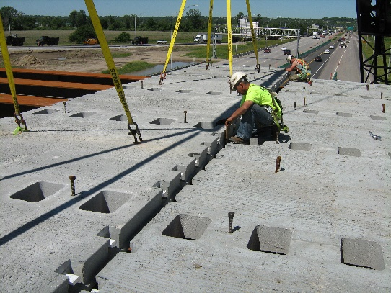
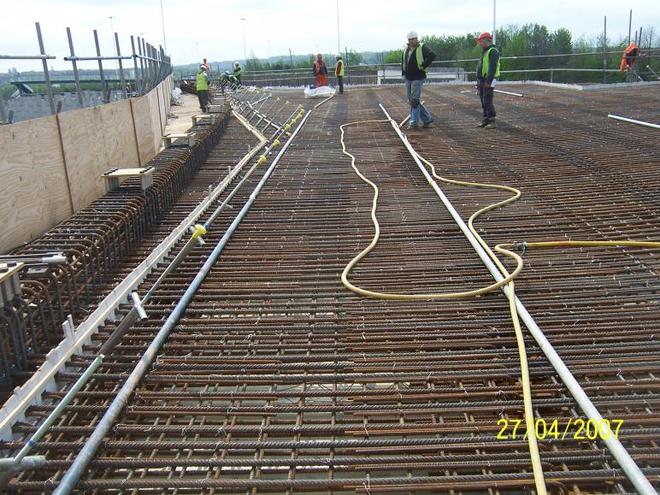
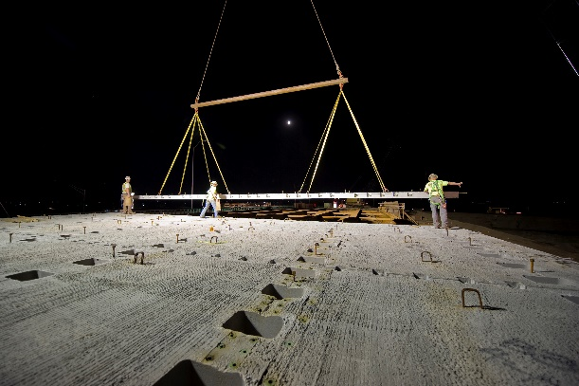
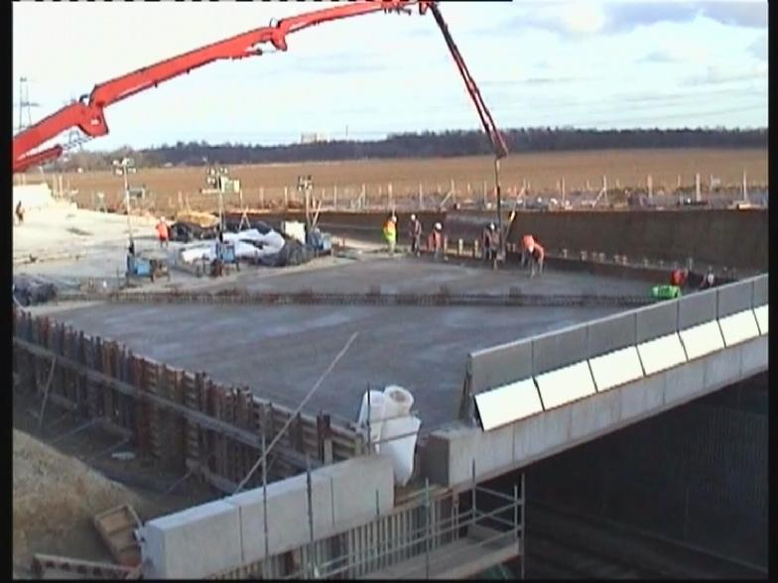
Full Depth Deck Panels
Accelerated
Conventional
(Iowa – 24th Street Bridge over I-29/I-80)
Notes:
Decks and bridge railing (parapets) are also often prefabricated to speed up construction and decrease labor costs.

Slide 17
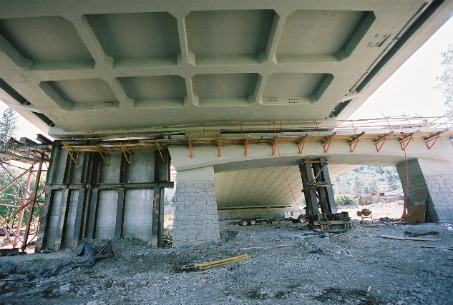


Lateral Slide
(Oregon – Depot Street Bridge)
Notes:
There are several other construction techniques that are used in Accelerated Bridge Construction. The first (shown here) is called the lateral slide method. For this method, the entire bridge span is constructed adjacent to the existing span. The existing span is removed and the new span is slid into place.

Slide 18

Lateral Slide
(Iowa – Messena Lateral Bridge Slide)
Notes:
This video shows how the lateral slide method works.

Slide 19





SPMTs
Self-Propelled Modular Transporter
(Louisiana – 3249 Wells Road)
Notes:
Another Accelerated Bridge Construction (ABC) technique involves the use of self-propelled modular transporters (SPMTs). For this method, the entire bridge span is constructed at a separate location from the bridge to be replaced. The existing bridge is then demolished and the new bridge is driven into place using SPMTs.

Slide 20

SPMTs
Notes:
This video shows a bridge being constructed using SPMTs.

Slide 21
ABC: Benefits and Disadvantages
ABC Benefits
  Shorter construction times
  Improved overall quality (generally)
  Decreased overall costs
ABC Disadvantages
  Increased construction cost
  New technologies (less general knowledge)
  Sometimes difficult connection details
Notes:
There are several benefits and disadvantages to Accelerated Bridge Construction (ABC), as shown.
ABC gets its name because it offers shorter construction times.
Because most ABC projects involve a significant amount of prefabrications, there is generally an overall improvement in quality.
Shorter construction times mean there is less cost to the public for traffic delays and problems with construction zones. Improved quality means that there are lower life-cycle costs. These both contribute to decreased overall costs for ABC projects.
There are however, normally higher initial construction costs. These initial costs should continue to decrease as more contractors become familiar with ABC techniques.
Many ABC techniques are still relatively new, so there is generally less knowledge and available resources (although this is changing thanks to the ABC-UTC in part).
The connection details can be difficult depending on the prefabricated elements that are used.

Slide 22



Bridge Engineering Activity
Bridge Designer Software
Balsa Wood Bridge (ABC-Style)
Notes:
The ABC Balsa Wood Bridge challenge (the activity that accompanies this presentation) will give you the opportunity to build their own bridge and explore several Accelerate Bridge Construction (ABC) techniques.
You will first design your bridge using a free available bridge design software (“Bridge Designer Software”)
You should consider constructability during your design. Part of the rules of this challenge require the bridge to be prefabricated in three different parts “off site” and then finished “on site”.
Additionally, if the design includes repeatable parts it will be easier to construct.

Slide 23






Selection of Bridge Type
Available Materials
Support Conditions and Span Details
$$10"$$
Design Space
$$6"$$
$$12"$$
$$36"$$
$$12"$$
Notes:
As we saw earlier, many different materials can be used when constructing a bridge. We will use balsa wood for our bridge (as described in the activity description).
The support conditions and span details are shown here (as described in the activity description).

Slide 24





Selection of Bridge Type
Type of Load
Other Considerations
Fast Construction
Notes:
A toy car and/or weights will be used to load the bridge
The bridge will need to be prefabricated in parts and the quickly constructed at the location of the bridge.

Slide 25


Balsa Wood Bridge Project
Trial
Notes:
Here are two different examples of balsa wood bridges constructed using the attached rules failing under a moving car load.

Slide 26
Thank You
Presentation Created by: David Garber, PhD (dgarber@fiu.edu)
Assistant Professor, Florida International University

