Slide 1
Welcome to Monthly Webinar on
Innovative Bridge Technologies / Accelerated Bridge Construction
Ultra-High Performance Concrete
Link Slab Design and Construction
Sponsored by
Innovative Bridge Technologies / Accelerated Bridge Construction - University Transportation Center
(IBT/ABC-UTC) at Florida International University
Website: abc-utc.fiu.edu
Email: abc@fiu.edu
April 18, 2024 – 1:00 p.m. to 2:15 p.m. Eastern
Notes:
Atorod will usually do the welcome.
If he does not:
Welcome to this month’s ABC-UTC Monthly Webinar. My name is Kathy Crowell. I’m Co-Director of Technology Transfer at the IBT/ABC-UTC and will be moderating today’s webinar. I’ll be assisted by Ali Javed, Ph.D. student at FIU, who is managing the web room. Atorod Azizinamini, Director of the ABC-UTC, sends his regrets for not being with us today. We welcome participants at approximately _____ registered sites today.

Slide 2
Today’s Monthly Webinar
IBT/ABC Announcements (10 minutes)
Featured Presentation (35-40 minutes)
Ultra-High Performance Concrete
Link Slab Design and Construction
by
Jim Scarlata, P.E., Assistant Director of the Structures Bureau,
New York State Department of Transportation
Question and Answer Session (15+ minutes)
Please post your questions in the question box
Notes:
For this month’s webinar, we’re pleased to feature:
The Fear peakle Concrete Bridge Rehabilitation Utilizing UHPFRC in Switzerland
Our Presenter is Professor Eugen Bruhwiler:
Since 1995, he is a Professor and doctor of structural engineering and Director of the Laboratory of Maintenance and Safety of Existing Structures at the Swiss Federal Institute of Technology in Law sson, Switzerland.
His teaching and research activities include methods of bridge examination of structural and fatigue safety by means of data from monitoring as well as the use of Ultra-High Performance Fibre Reinforced Cementitious Composites (UHPFRC) for the rehabilitation and strengthening of existing RC structures and the design and construction of new UHPFRC structures.
Please post your questions in the questions pod for today’s presentation.
The question and answer session will be moderated by Paul Liles, former Georgia DOT State Bridge Engineer, and Jamal Elk – ki’ – see, a structural engineer in the FHWA Resource Center
I’d also like to thank Ali Javid and Suri for their help with managing the webroom and keeping us all coordinated.
I’ll now give screen controls to Prof Brew wiler

Slide 3
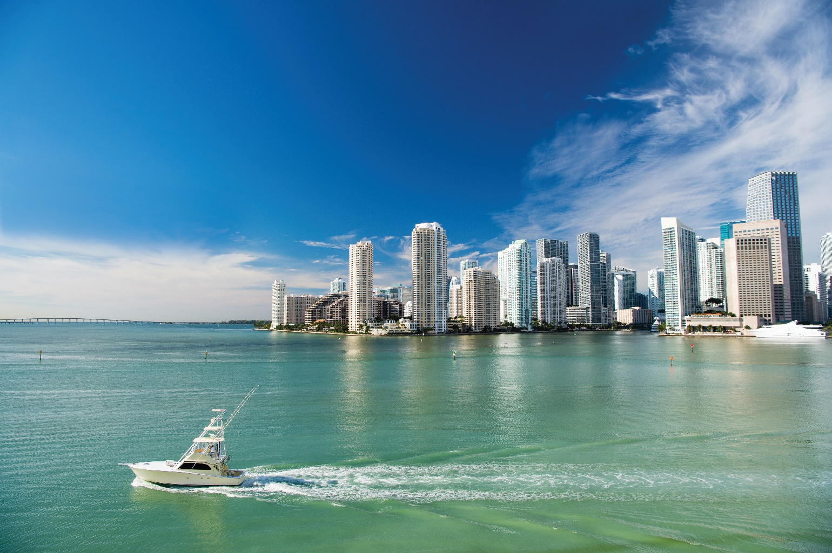
2024 World Bridge Engineering Conference
Hilton Hotel, December 13, 14 and 15, 2024, Miami FL
We have received record number of abstracts
CALL FOR ABSTRACTS
Extended Deadline
May 30

Slide 4
2024 World Bridge Engineering Conference

Slide 6
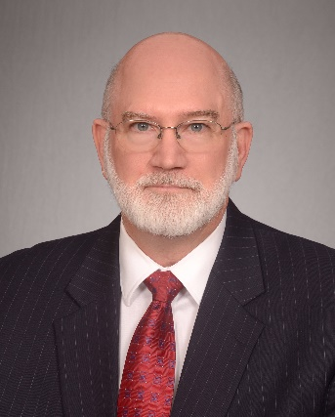
2024 World Bridge Engineering Conference
Hilton Hotel, December 13, 14 and 15, 2024, Miami FL
Keynote Speakers
Keynote Speaker: Michael Knott, PE, Senior Vice President Emeritus, with Moffatt & Nichol.
Presentation Title: What bridge designers should know about ships colliding with bridges and how to prevent collapse.

Slide 7
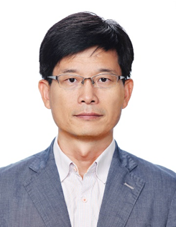
2024 World Bridge Engineering Conference
Hilton Hotel, December 13, 14 and 15, 2024, Miami FL
Keynote Speakers
Keynote Speaker: Changsu Shim, PhD, Professor, Department of Civil, Environmental Engineering and Urban Design, Chung-Ang University
Presentation Title: Digitalized highway bridge construction using smart technologies in Korea

Slide 8
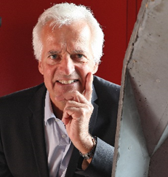
2024 World Bridge Engineering Conference
Hilton Hotel, December 13, 14 and 15, 2024, Miami FL
Keynote Speakers
Keynote Speaker: Eugen Brühwiler, Prof. em. Ph.D., P.E., Swiss Federal Institute of Technology (EPFL) Lausanne, Switzerland
Presentation Title: Current developments in Europe in rescuing existing bridges with UHPC

Slide 9
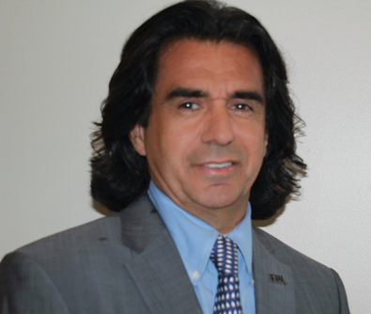
2024 World Bridge Engineering Conference
Hilton Hotel, December 13, 14 and 15, 2024, Miami FL
Keynote Speakers
Keynote Speaker: Atorod Azizinamini, PhD, PE
Presentation Title: 3D printing with concrete

Slide 10
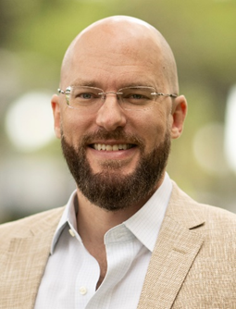
2024 World Bridge Engineering Conference
Hilton Hotel, December 13, 14 and 15, 2024, Miami FL
Keynote Speakers
Keynote Speaker: Professor Mark A. Finlayson, FIU, MIT educated
Presentation Title: What is Artificial Intelligence, and Why Should Bridge Engineers Care?

Slide 11
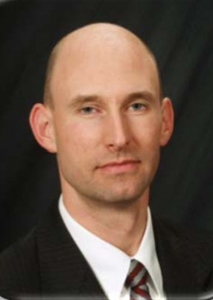
2024 World Bridge Engineering Conference
Hilton Hotel, December 13, 14 and 15, 2024, Miami FL
Keynote Speakers
Keynote Speaker: Benjamin A. Graybeal, Ph.D, P.E., U.S. Federal Highway Administration
Presentation Title: Solutions that Move the Needle

Slide 12
2024 World Bridge Engineering Conference
Hilton Hotel, December 13, 14 and 15, 2024, Miami FL
Travel Scholarships are available
For U.S. State and County Bridge Engineers

Slide 13
2024 World Bridge Engineering Conference
Hilton Hotel, December 13, 14 and 15, 2024, Miami FL
Opportunities are available to exhibit (Space is limited)

Slide 14
2024 World Bridge Engineering Conference
Hilton Hotel, December 13, 14 and 15, 2024, Miami FL
Award Program

Slide 15
2024 World Bridge Engineering Conference
Hilton Hotel, December 13, 14 and 15, 2024, Miami FL
Please spread the word
Share with bridge professionals in your area

Slide 16
Upcoming Events
ESWP –
Engineers’ Society of Western Pennsylvania
International Bridge Conference (IBC)
June 3-5, 2024
San Antonio, Texas
For more information and registration:
www.eswp.com/bridges/ibcregistration/
Notes:
Welcome to today’s webinar
I’ll take a short time to share some industry news.
For starters, Gregg Freeby with the
American Segmental Bridge Institute
would like to remind you that ASBI will be hosting their
annual convention and committee meetings this year on
November 5th through 8th at the
Westin La Paloma Resort and Spa in Tucson, Arizona.
Information and Registration can be found on the ASBI website.
or contact Gregg Freeby at the email shown on the screen.

Slide 17
Upcoming Events
ACMA –
American Composites Manufacturing Association
Composites Sustainability Today Conference (CST24)
Preparing Your Business for the Future
June 4 - 6, 2024
Denver, Colorado
For more information and registration: https://acma-org.my.site.com/csft24/
Notes:
Welcome to today’s webinar
I’ll take a short time to share some industry news.
For starters, Gregg Freeby with the
American Segmental Bridge Institute
would like to remind you that ASBI will be hosting their
annual convention and committee meetings this year on
November 5th through 8th at the
Westin La Paloma Resort and Spa in Tucson, Arizona.
Information and Registration can be found on the ASBI website.
or contact Gregg Freeby at the email shown on the screen.

Slide 18
Upcoming Events
Canadian Assoc for Earthquake Engineering and Seismology and Carleton University
4th International Bridge Seismic Workshop
August 11-14, 2024
Ottawa, Ontario
Abstract Submission Deadline – April 30, 2024
For more information and registration: https://carleton.ca/4ibsw/registration/
Notes:
Welcome to today’s webinar
I’ll take a short time to share some industry news.
For starters, Gregg Freeby with the
American Segmental Bridge Institute
would like to remind you that ASBI will be hosting their
annual convention and committee meetings this year on
November 5th through 8th at the
Westin La Paloma Resort and Spa in Tucson, Arizona.
Information and Registration can be found on the ASBI website.
or contact Gregg Freeby at the email shown on the screen.

Slide 19
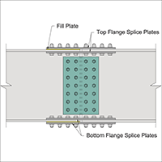
News of Note:
AISC - NSBA –
American Institute of Steel Construction –
National Steel Bridge Alliance
Bolted Splice Spreadsheet – Update Released (version 3.15)
https://www.aisc.org/nsba/design-resources/nsba-splice/
For more information contact Vin Bartucca:
bartucca@steelbridges.org
Notes:
Welcome to today’s webinar
I’ll take a short time to share some industry news.
For starters, Gregg Freeby with the
American Segmental Bridge Institute
would like to remind you that ASBI will be hosting their
annual convention and committee meetings this year on
November 5th through 8th at the
Westin La Paloma Resort and Spa in Tucson, Arizona.
Information and Registration can be found on the ASBI website.
or contact Gregg Freeby at the email shown on the screen.

Slide 20
Quarterly Research Seminar
Friday, April 26, 2024 – 1:00-2:15 p.m. Eastern
(Certificate of Attendance provided)
Featured Project:
Insights into the Pull-Off Strength of Polymer Concrete and the Effects of Nanomodifications
by
Ali Akbarpour, Ph.D. Student; and
Shreya Vemuganti, Ph.D., Assistant Professor, Principle Investigator
ABC-UTC at The University of Oklahoma
Register Now!
Notes:
Now, back to the
IBT/ABC-UTC events.
We have our Quarterly research seminar coming up at the end of October, on the 27th from 1-2:15.
The featured project will be #D printing using UHPC
The presenters will be our own:
Dr. Azizinamini and PhD Candidate Ali Javed
Registration is open

Slide 21
Next Monthly Webinar
Thursday, May 16, 2024 – 1:00-2:15 p.m. Eastern
(Certificate of Attendance provided)
Featured Presentation:
BTC Method for the Evaluation of
In-Place Bridge Cables
by
Khaled Mahmoud, Ph.D, P.E., Chief Bridge Engineer, BTC
Mark your Calendars!
Notes:
Our next monthly webinar will be held on November 9 from 1-2:15 EST.
We are honored to be joined by Dr Firas Ibrahim
Who is the Director of Research, Development and Technology at USDOT’s office of the assistant secretary
Dr Ibrahim will be discussing the USDOT’s new strategic plan with emphasis on bridges.
He will be followed by Ted ka knees o witz, the Tennessee DOT Director of Structures
And Rick Liptak, the Michigan DOT Chief Bridge Construction Engineer
Both of whom will be offering state perspectives on future of bridge engineering.
This is a unique opportunity to hear leaders of our industry share their vision for the trajectory of our profession. Q&A will follow.
Please mark your calendar – for November 9.

Slide 22
In-Depth Web Training
Tuesday, September 10, 2024 – 11:00-3:15 p.m. Eastern
(Certificate of Attendance provided)
Innovations in
Ultra-High Performance Concrete
Mark your Calendars!
Notes:
Our next monthly webinar will be held on November 9 from 1-2:15 EST.
We are honored to be joined by Dr Firas Ibrahim
Who is the Director of Research, Development and Technology at USDOT’s office of the assistant secretary
Dr Ibrahim will be discussing the USDOT’s new strategic plan with emphasis on bridges.
He will be followed by Ted ka knees o witz, the Tennessee DOT Director of Structures
And Rick Liptak, the Michigan DOT Chief Bridge Construction Engineer
Both of whom will be offering state perspectives on future of bridge engineering.
This is a unique opportunity to hear leaders of our industry share their vision for the trajectory of our profession. Q&A will follow.
Please mark your calendar – for November 9.

Slide 23
Today’s Monthly Webinar
IBT/ABC Announcements (10 minutes)
Featured Presentation (35-40 minutes)
Ultra-High Performance Concrete
Link Slab Design and Construction
by
Jim Scarlata, P.E., Assistant Director of the Structures Bureau,
New York State Department of Transportation
Question and Answer Session (15+ minutes)
Please post your questions in the question box
Notes:
For this month’s webinar, we’re pleased to feature:
The Fear peakle Concrete Bridge Rehabilitation Utilizing UHPFRC in Switzerland
Our Presenter is Professor Eugen Bruhwiler:
Since 1995, he is a Professor and doctor of structural engineering and Director of the Laboratory of Maintenance and Safety of Existing Structures at the Swiss Federal Institute of Technology in Law sson, Switzerland.
His teaching and research activities include methods of bridge examination of structural and fatigue safety by means of data from monitoring as well as the use of Ultra-High Performance Fibre Reinforced Cementitious Composites (UHPFRC) for the rehabilitation and strengthening of existing RC structures and the design and construction of new UHPFRC structures.
Please post your questions in the questions pod for today’s presentation.
The question and answer session will be moderated by Paul Liles, former Georgia DOT State Bridge Engineer, and Jamal Elk – ki’ – see, a structural engineer in the FHWA Resource Center
I’d also like to thank Ali Javid and Suri for their help with managing the webroom and keeping us all coordinated.
I’ll now give screen controls to Prof Brew wiler

